Slide 1
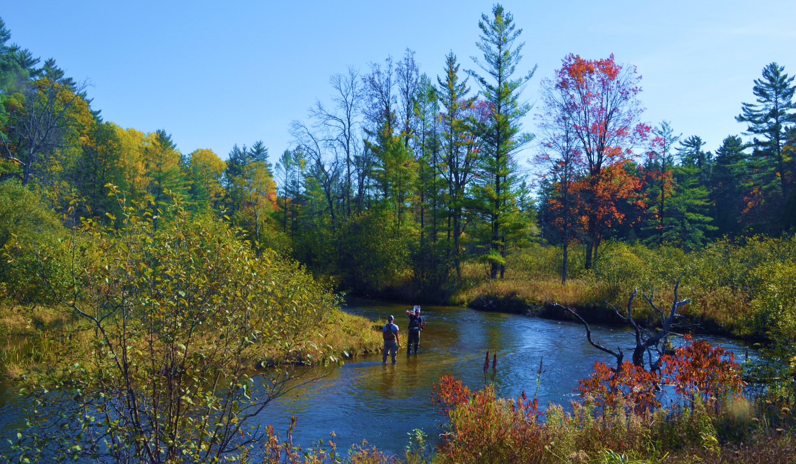
The Little Manistee Watershed
Planning for high-quality water

Slide 2
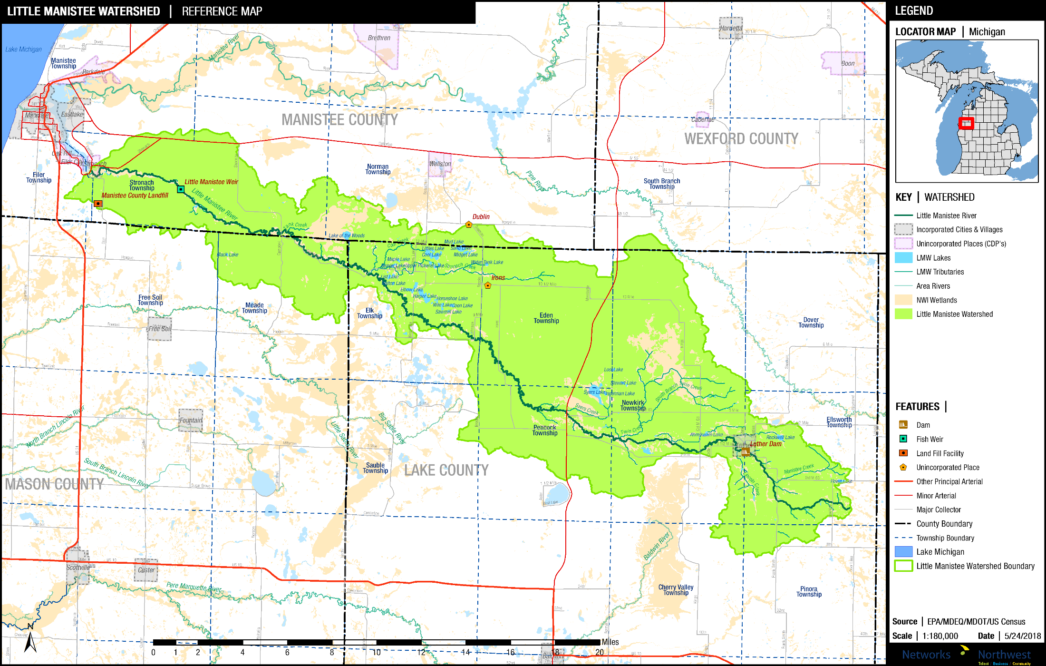
The Little Manistee River Watershed
Lake, Manistee, Mason and Wexford Counties

Slide 3
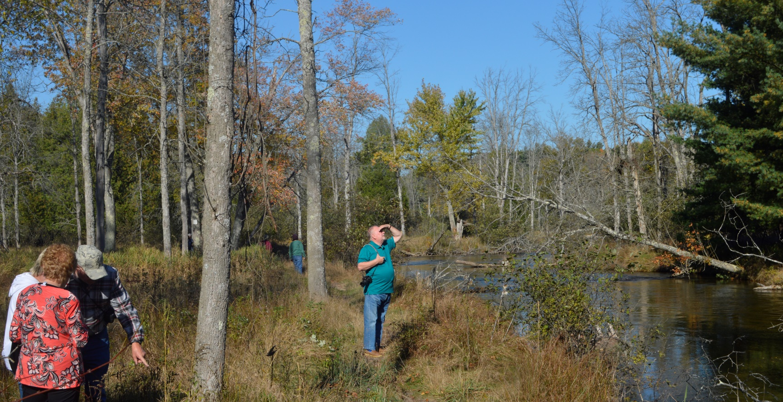
Why Watershed Planning?
Determine present conditions
Consider clean-water standards
Generate Stakeholder input
Begin Public Education
Identify problem areas
Develop solutions
Apply for funding
Monitor progress

Slide 4
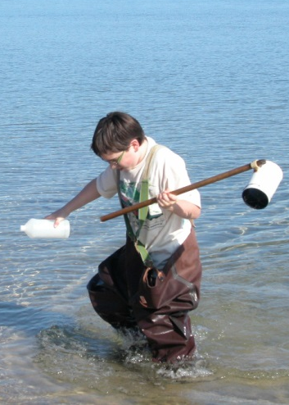
Watershed Questions:
What do we have?
What do we want?
How do we get from A to B?

Slide 5
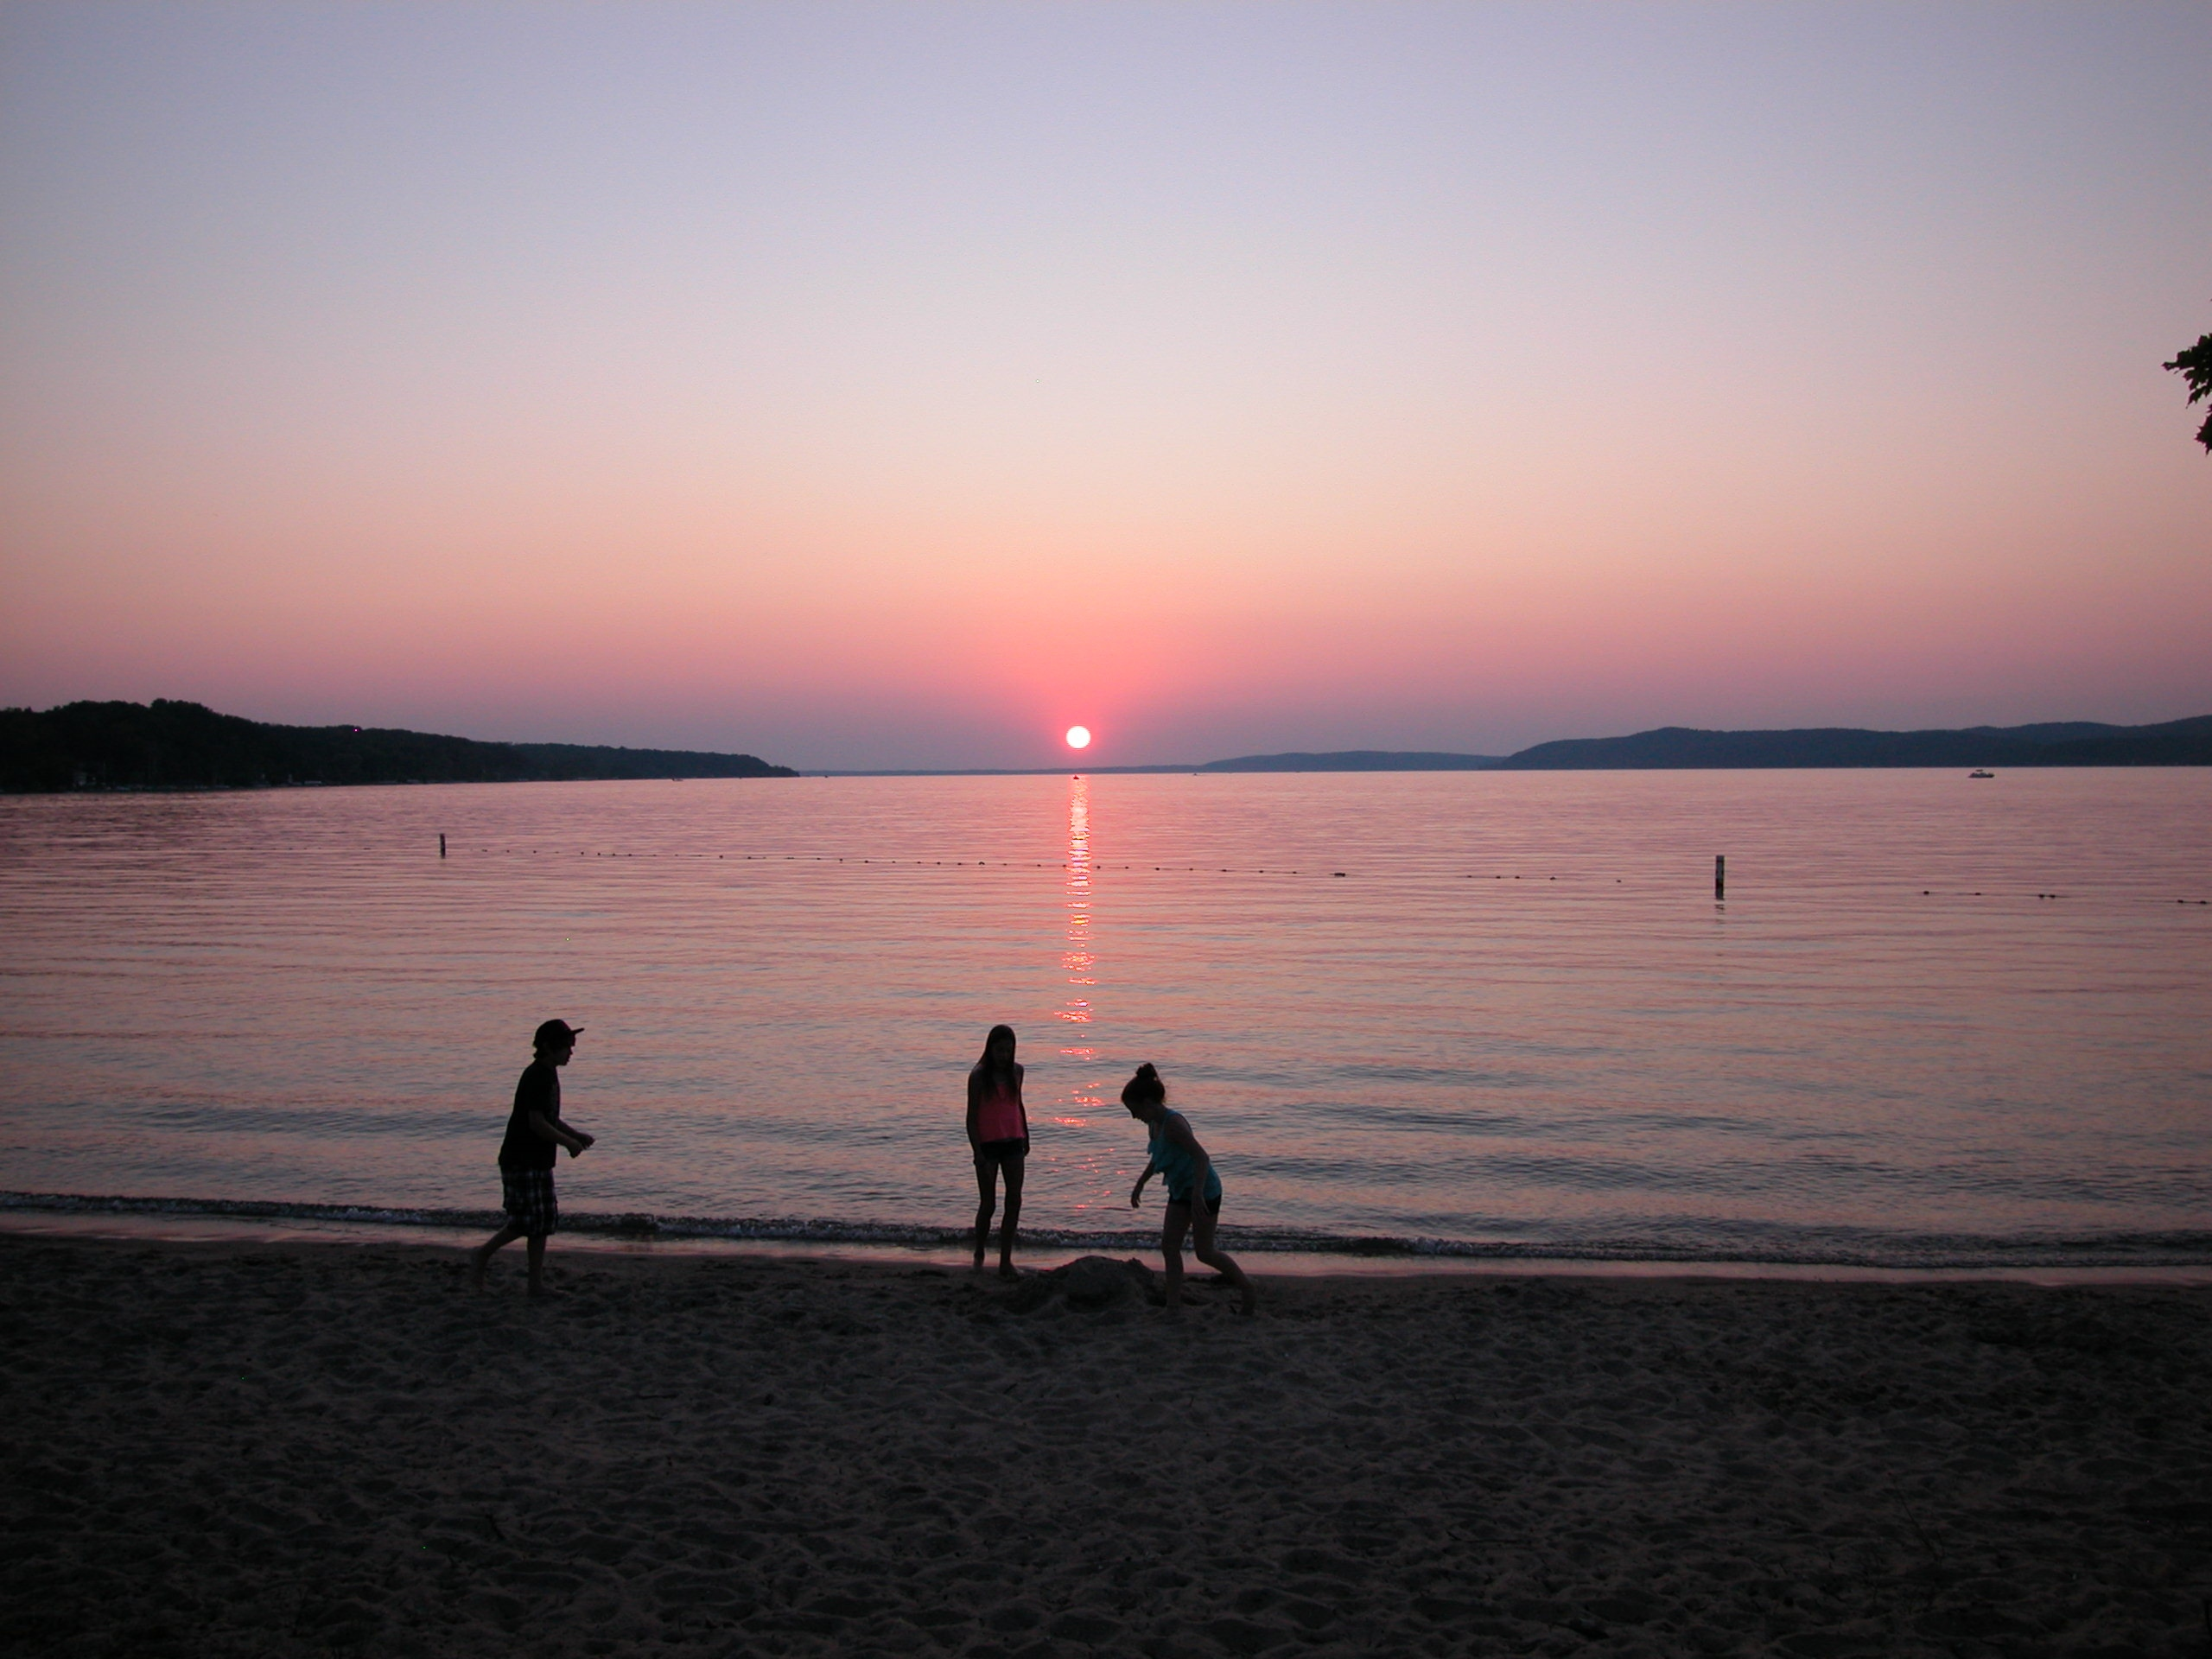
Little Manistee WMP Partners
Little Manistee Watershed Conservation Council
Conservation Resource Alliance
Manistee Conservation District
Lake County Community Foundation
Manistee County Community Foundation
U.S. Forest Service
Michigan DNR and DEQ
Little River Band of Ottawa Indians
Trout Unlimited
Local government agencies
Alliance for Economic Success

Slide 6
The Plan MUST:
Maintain or improve water quality
Meet standards for full-body contact recreation
Protect or improve the fishery
Protect navigation
Include public education

Slide 7
The Plan MAY:
Consider scenic and recreational values
Address economic conditions
Include public access
Add locally important issues

Slide 8
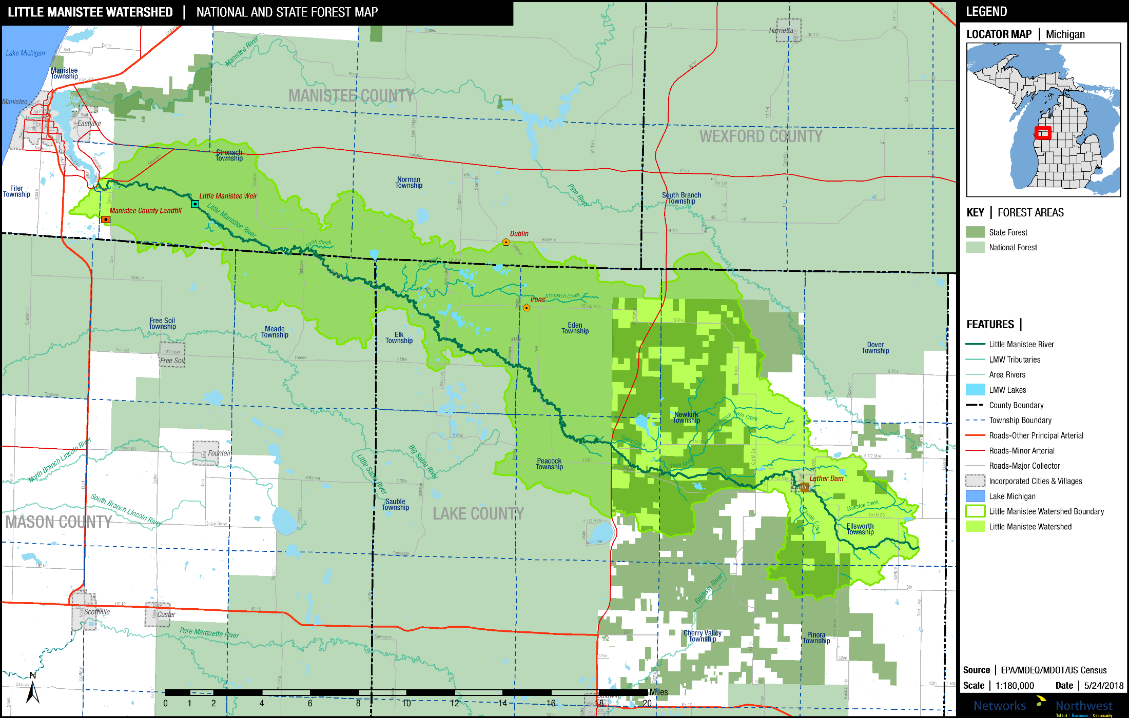
State and National Forest Lands

Slide 9
Land Cover in Little Manistee Watershed
Vegetation Type
Deciduous Forest 39.1%
Mixed & Evergreen Forest 28.3%
Scrub & Grassland 14.2%
Land Use
Developed 5.0%
Agriculture 3.5%
Water & Wetlands 9.7%

Slide 10
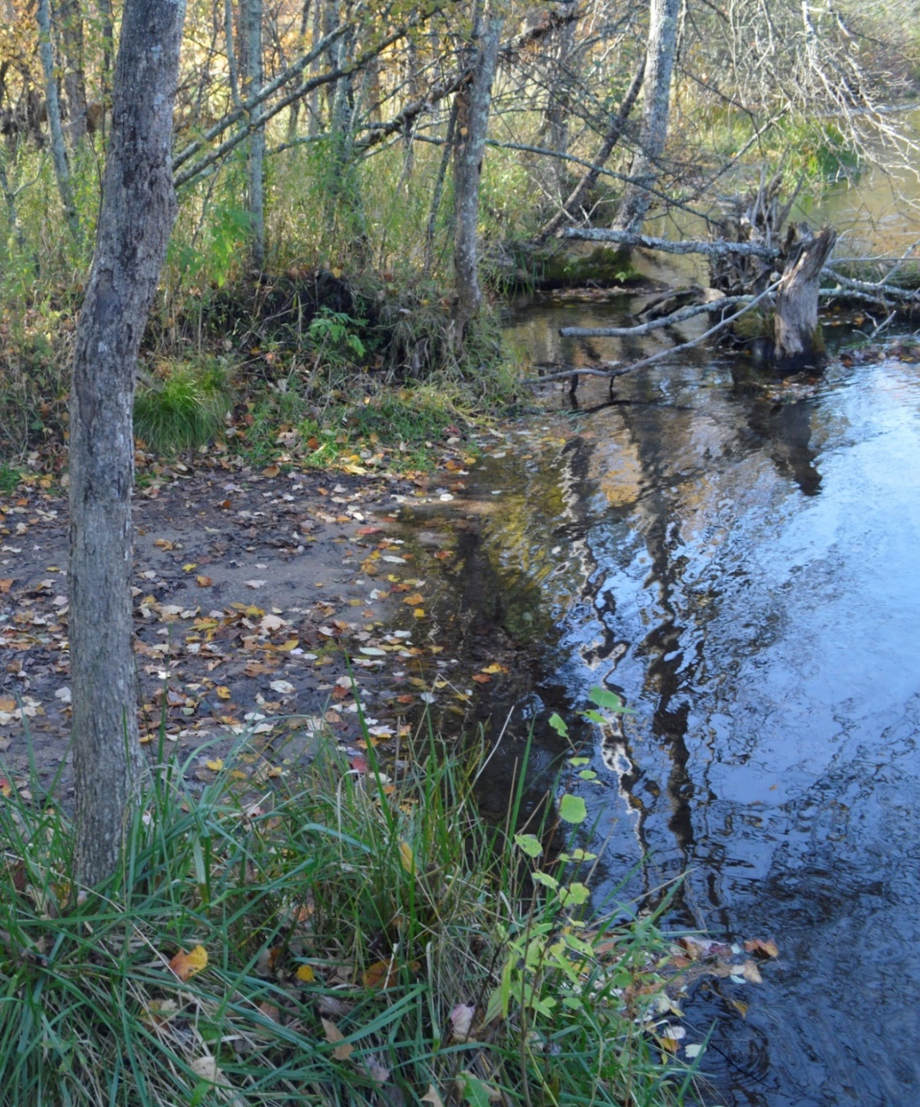
Non Point Source (“NPS”) Stressors
Little Manistee Watershed Priority Levels
Level 1
Thermal Issues
Sediments
Level 2
Excessive nutrients
Invasive Species
Biological pathogens
Level 3
Other unspecified
pollutants

Slide 11
Potential Sources of NPS Pollution
Land Use (Stormwater runoff from impervious surfaces)
Transportation (Erosion at road-stream crossings)
Septic Systems (Nutrients and E. coli from failing systems)
Recreation (Erosion, spread of invasive species)
Agriculture (Fertilizer, pesticides, erosion)
Dams/Impoundments (Sedimentation, thermal issues)

Slide 12
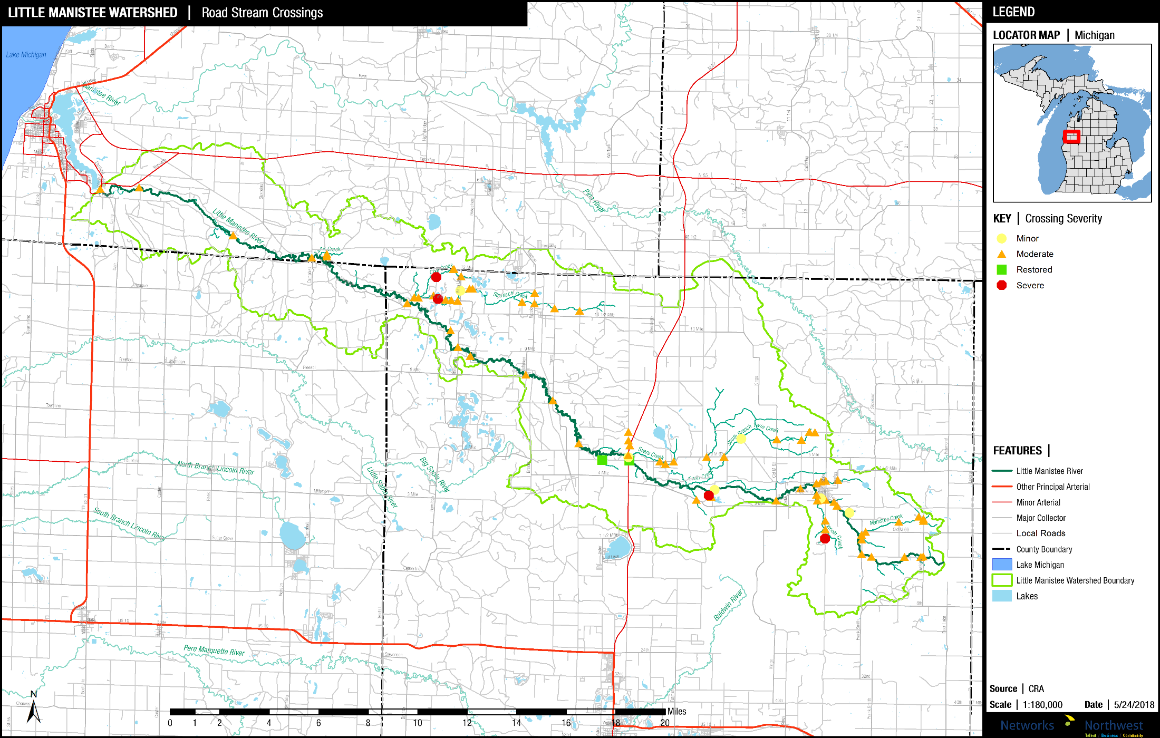
The Little Manistee Watershed has more than 80 road-stream crossings

Slide 13
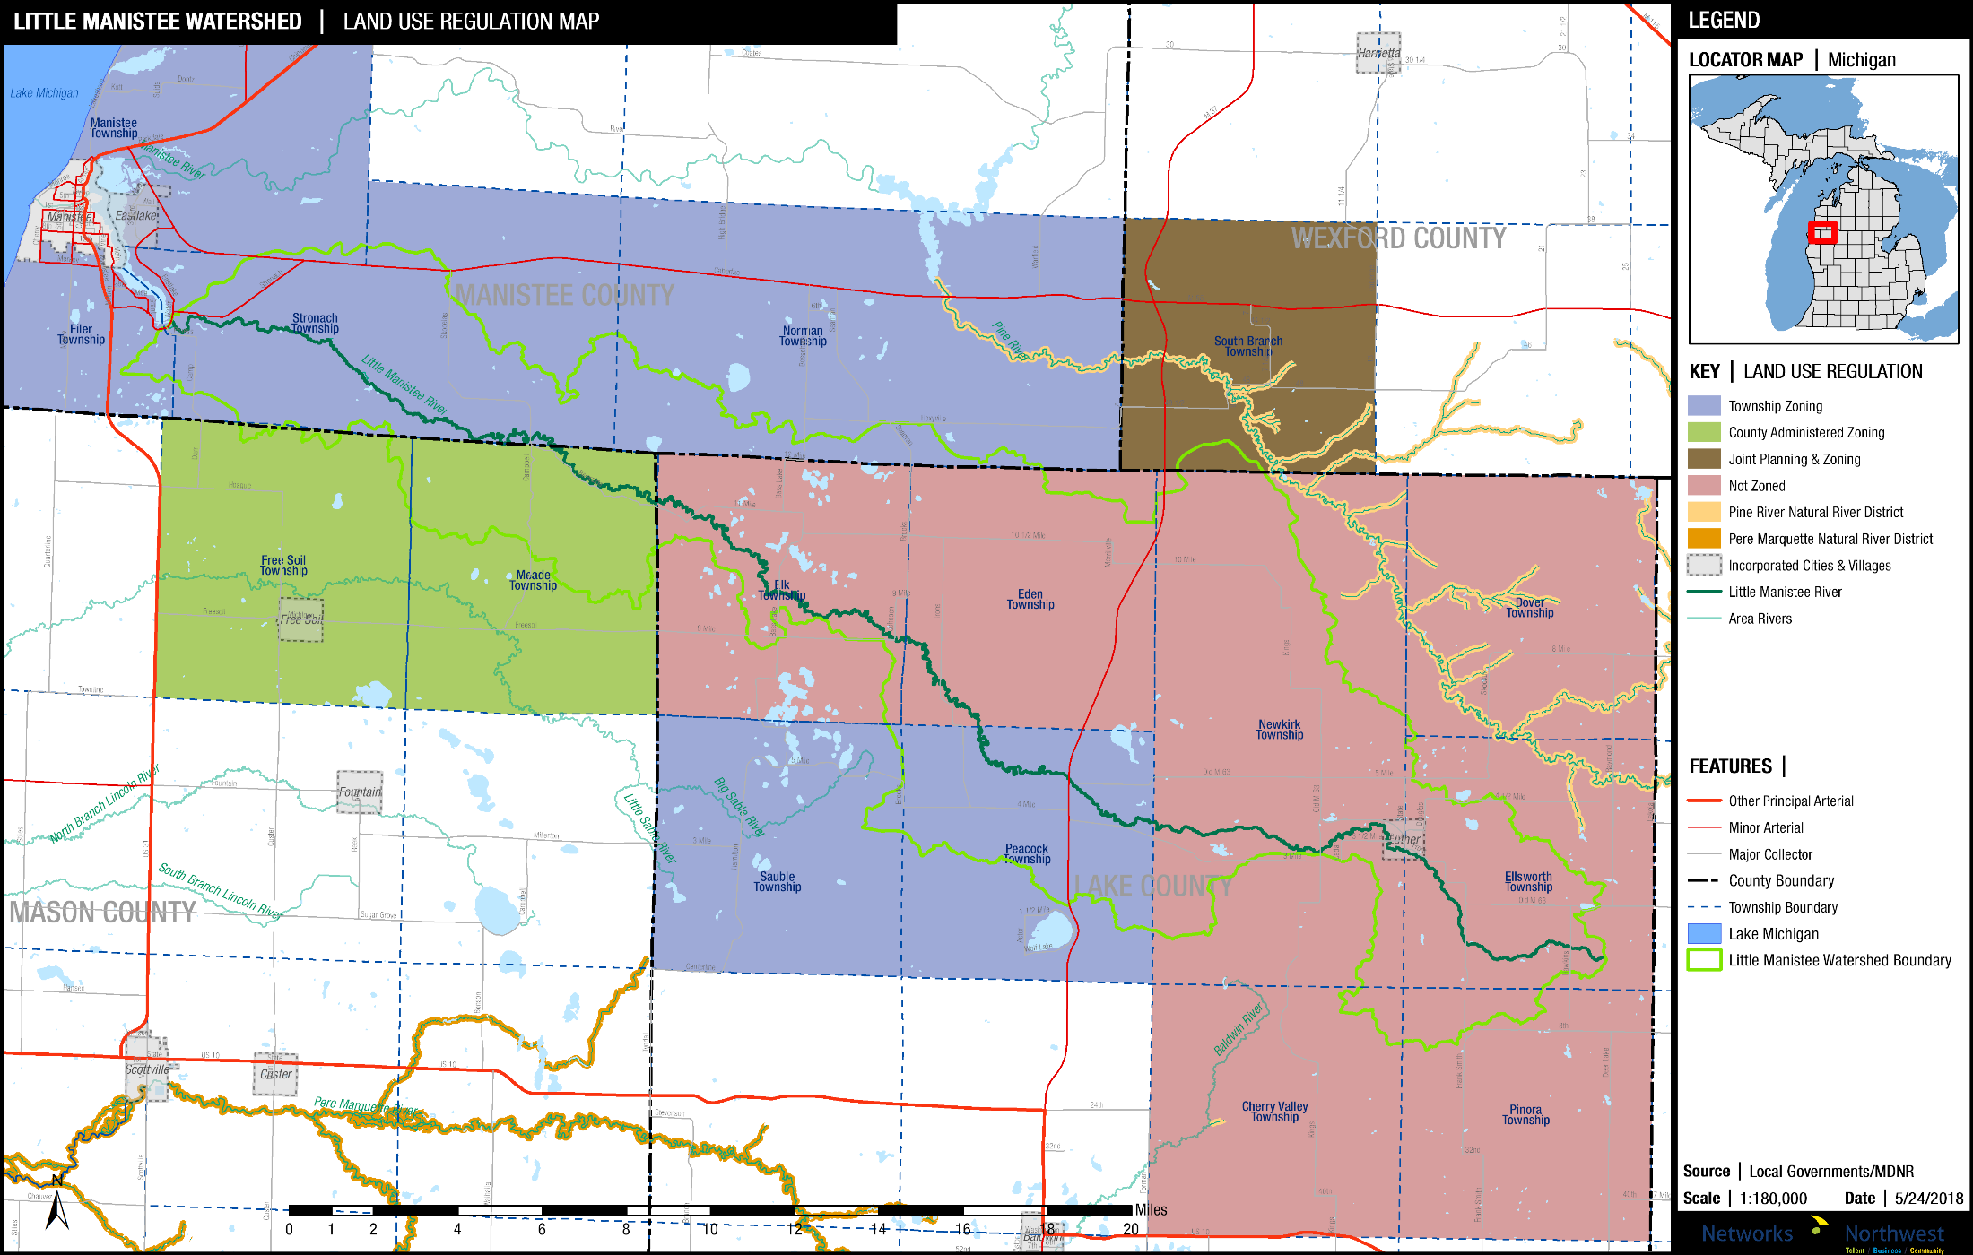
Existing Land Use Regulation

Slide 14
Zoned Area of Watershed (Acres)
Zoned Township Administered 42,854
Zoned County Administered 10,929
Joint Planning & Zoning 626
Total Zoned in Watershed 54,410
Total Watershed Area (Acres) 134,995
% of Watershed Zoned 40.3%

Slide 15
Planning & Zoning Best Practices
Environmental Protection Priorities
Economics of Environmental Stewardship
Wetland & Shoreline Protections
Buffers & Setbacks
Steep Slope Protections
Minimize Impervious Surfaces
Low Impact Develop (“LIDs”) Incentives

Slide 16
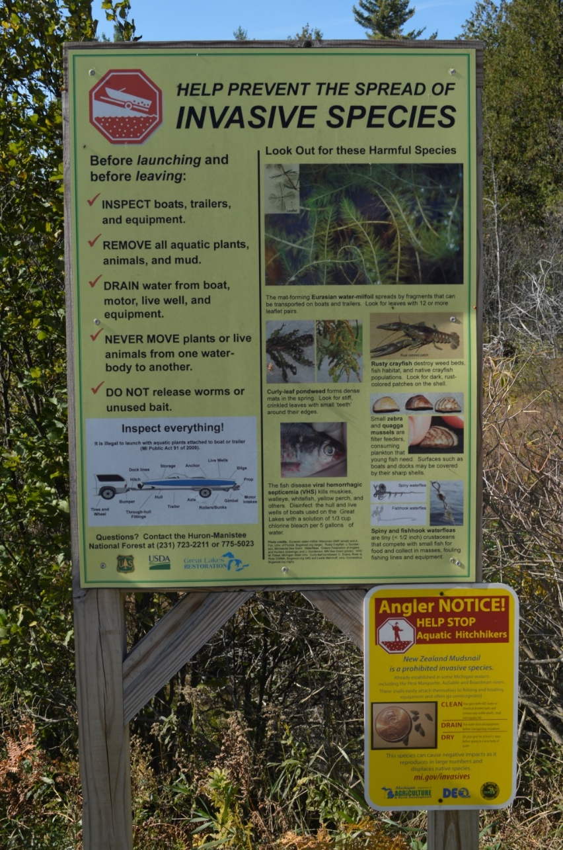
The Draft WMP Calls For:
Land Use Education
Water Quality Monitoring
Habitat Improvement
Streambank Stabilization
Road-Stream Repairs
Groundwater Protection
Optional Actions to Guide Future Land-Uses

Slide 17
Implementing the Little Manistee Plan
12 categories, 63 specific tasks

Slide 18
Implementation Categories A-B-C-D
Shoreline/Streambank Issues $449,000
Stormwater and Runoff $74,000
Planning, Zoning and Land Use $25,000
Road-Stream Issues $4,292,000

Slide 19
Implementation Categories E-F-G-H
Cat. E. Land Protection and Management $1,010,000
Cat. F. Habitat for Fish and Wildlife $280,000
Cat. G. Recreation, Safety, Navigation, Health* N/A
Cat. H Groundwater and Wetlands $40,000
(Cat. F estimate does not include option for dam removal)
(Cat. G costs are included in other line items)

Slide 20
Implementation Categories I-J-K-L
Water Quality Monitoring $70,000
Invasive Species $18,000
Wastewater and Septic Systems $335,000
Information and Education $81,000

Slide 21
Total Implementation Costs Estimate
TOTAL 10-year Cost: $6,674,000

Slide 22
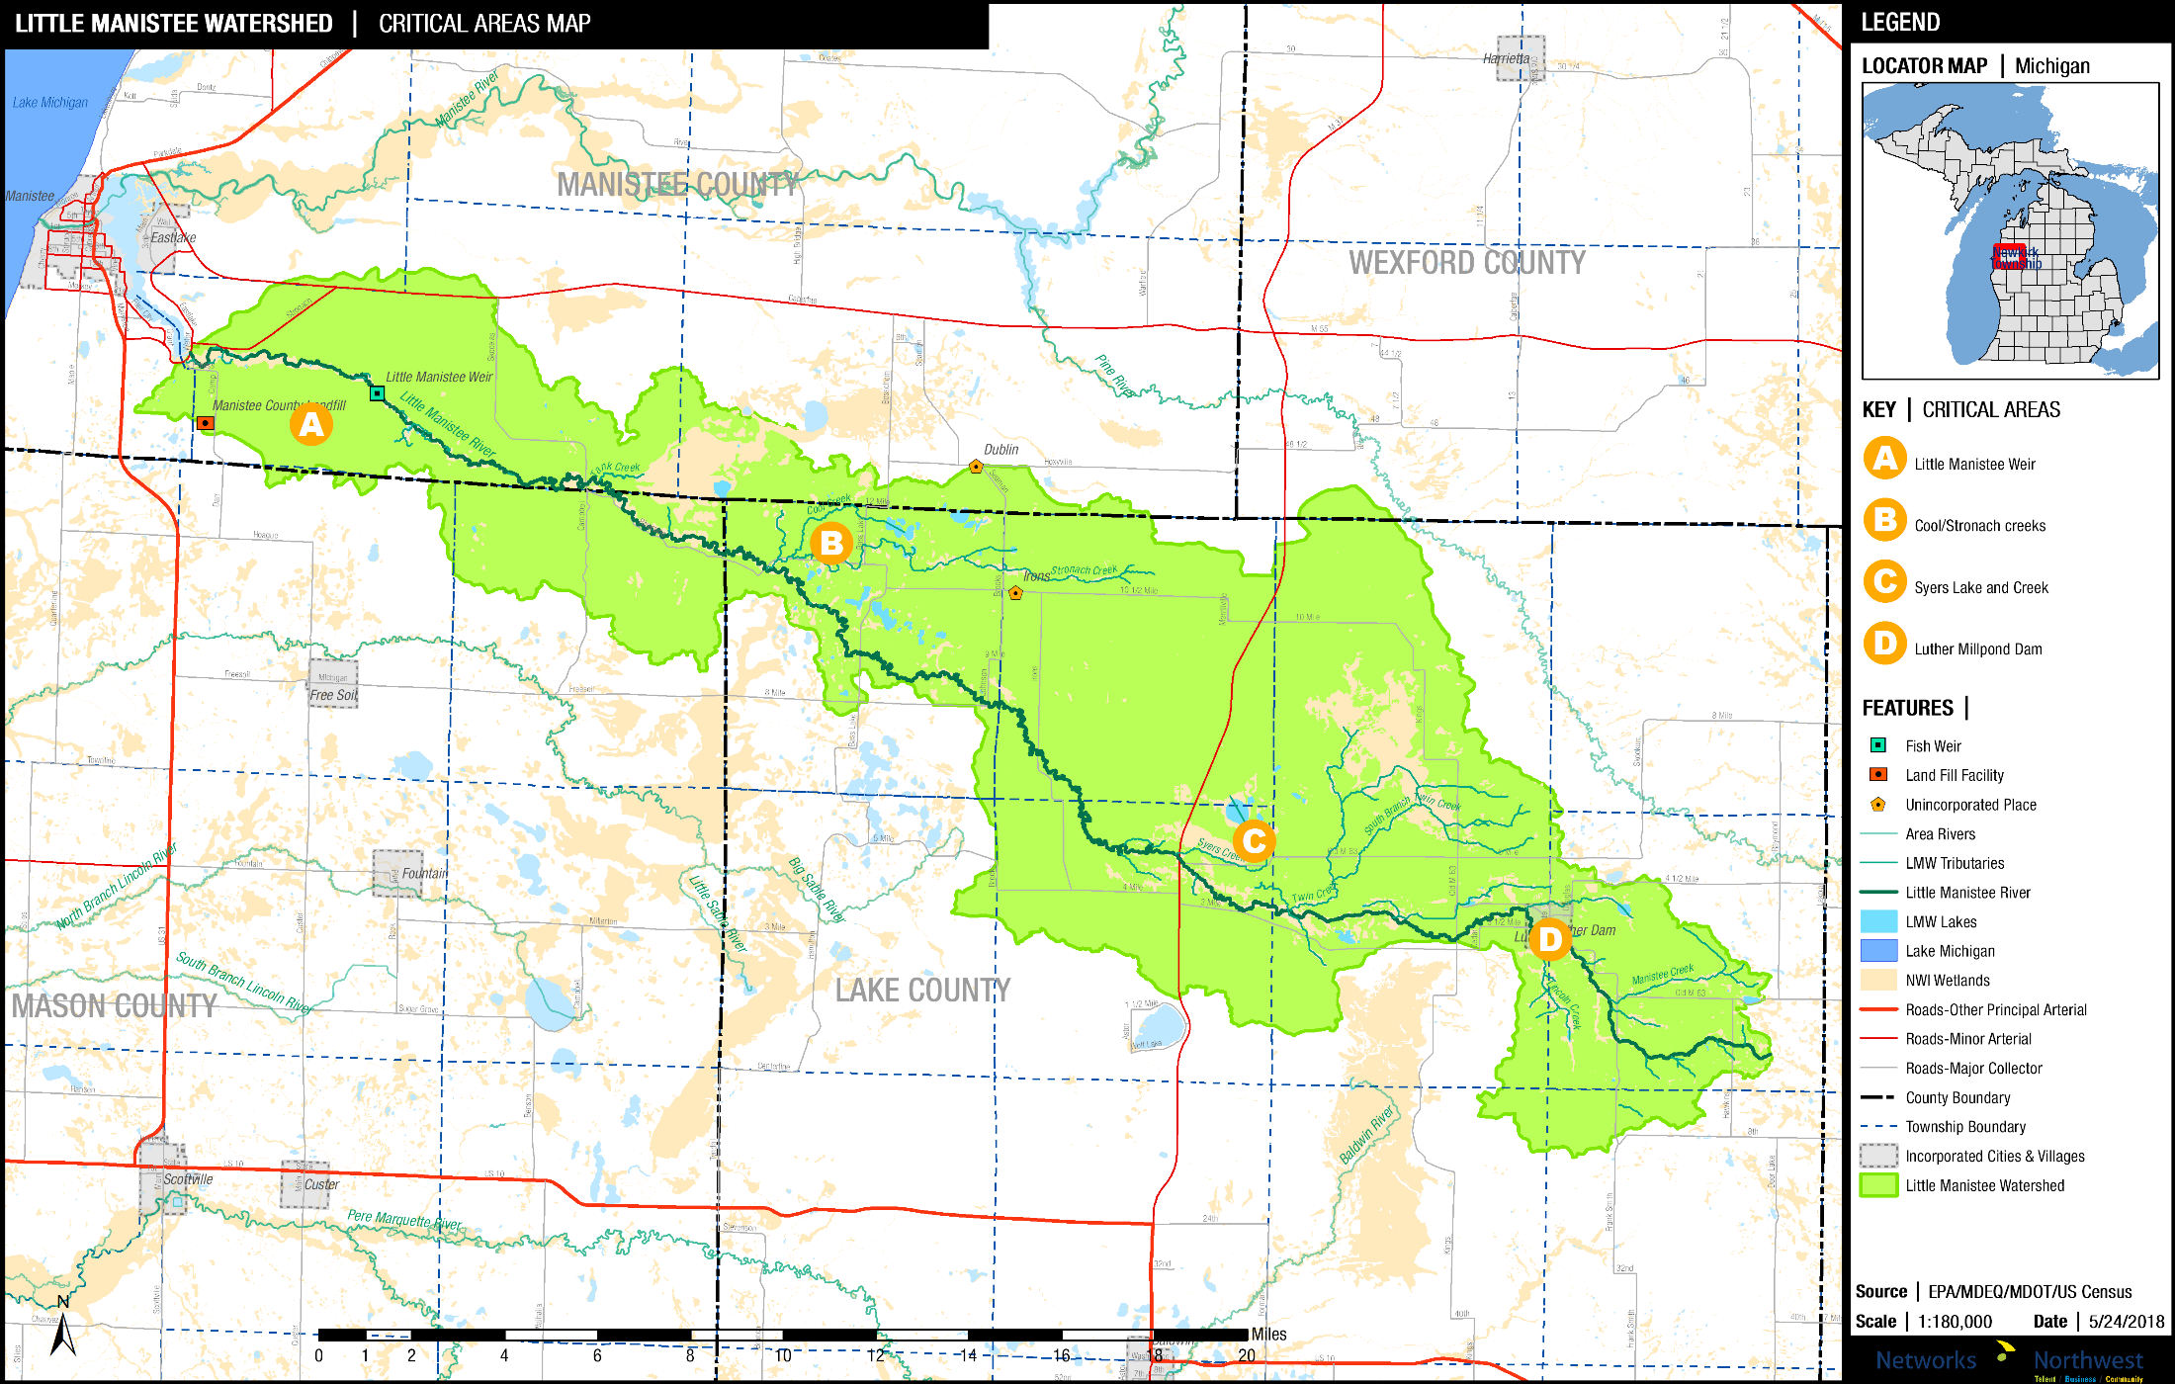
Critical Areas for Remediation and/or Protection

Slide 23
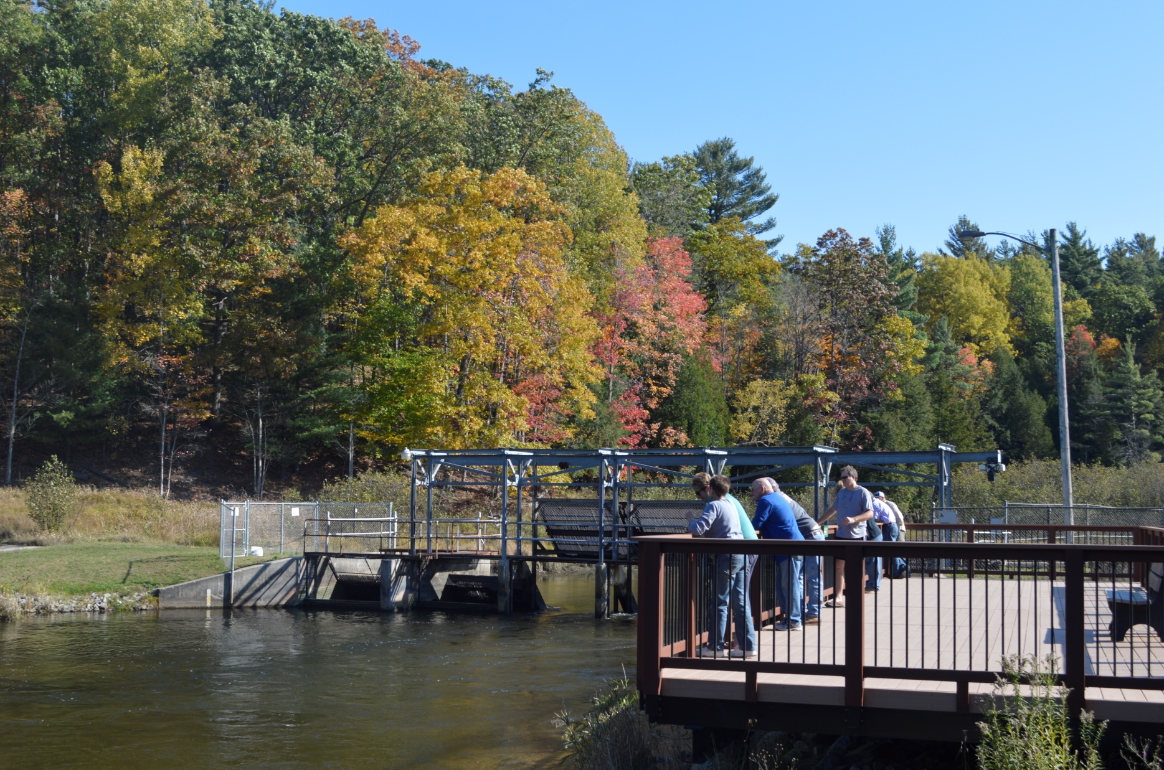
Little Manistee Weir and Egg-Taking Station

Slide 24
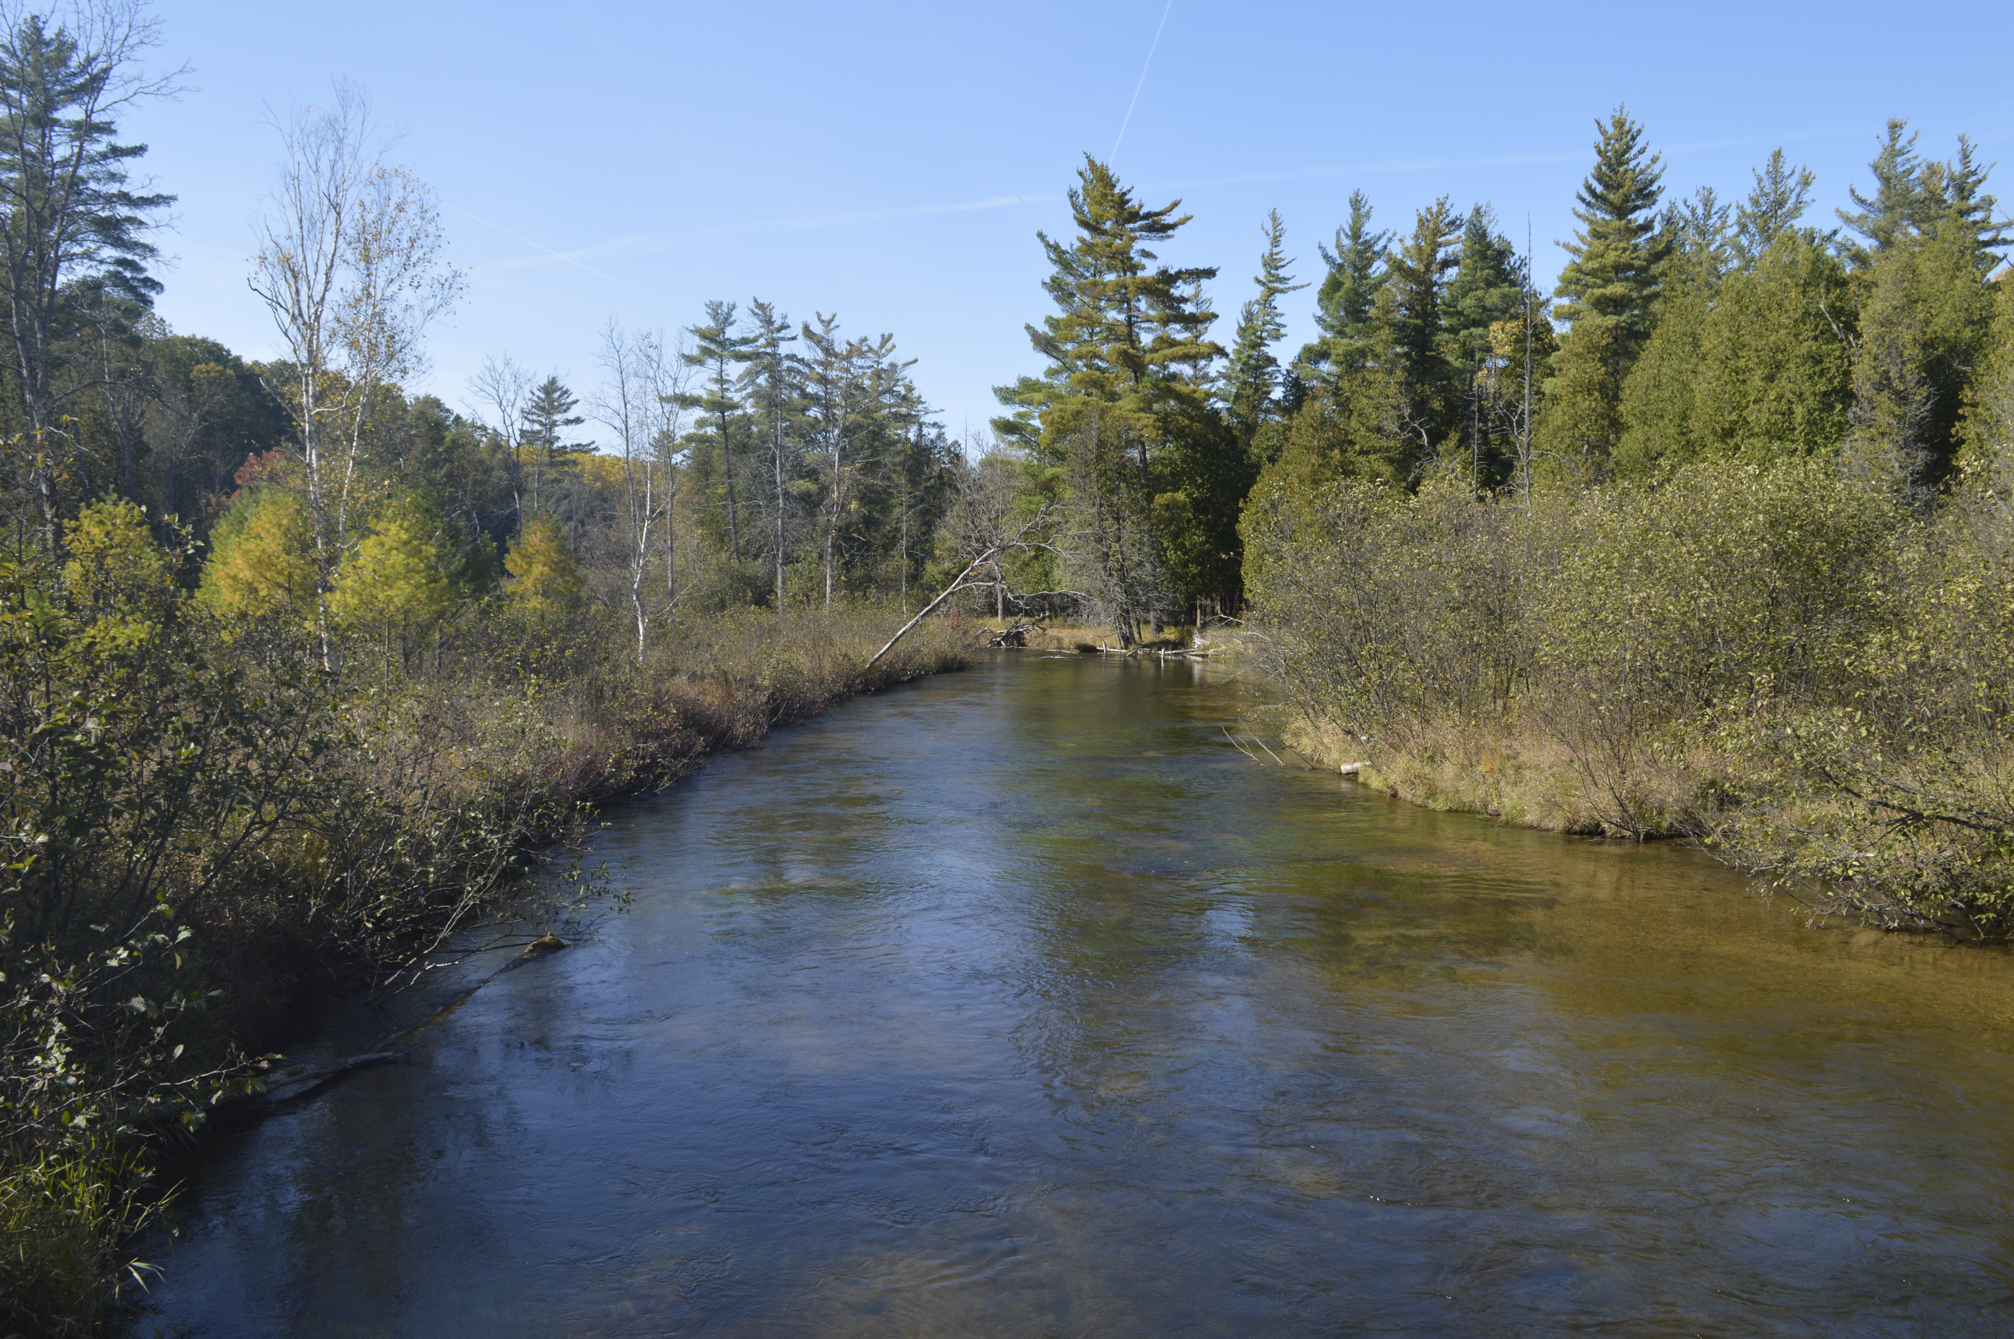
Cool Creek / Stronach Creek Critical Area
Syers Lake / Syers Creek Critical Area

Slide 25
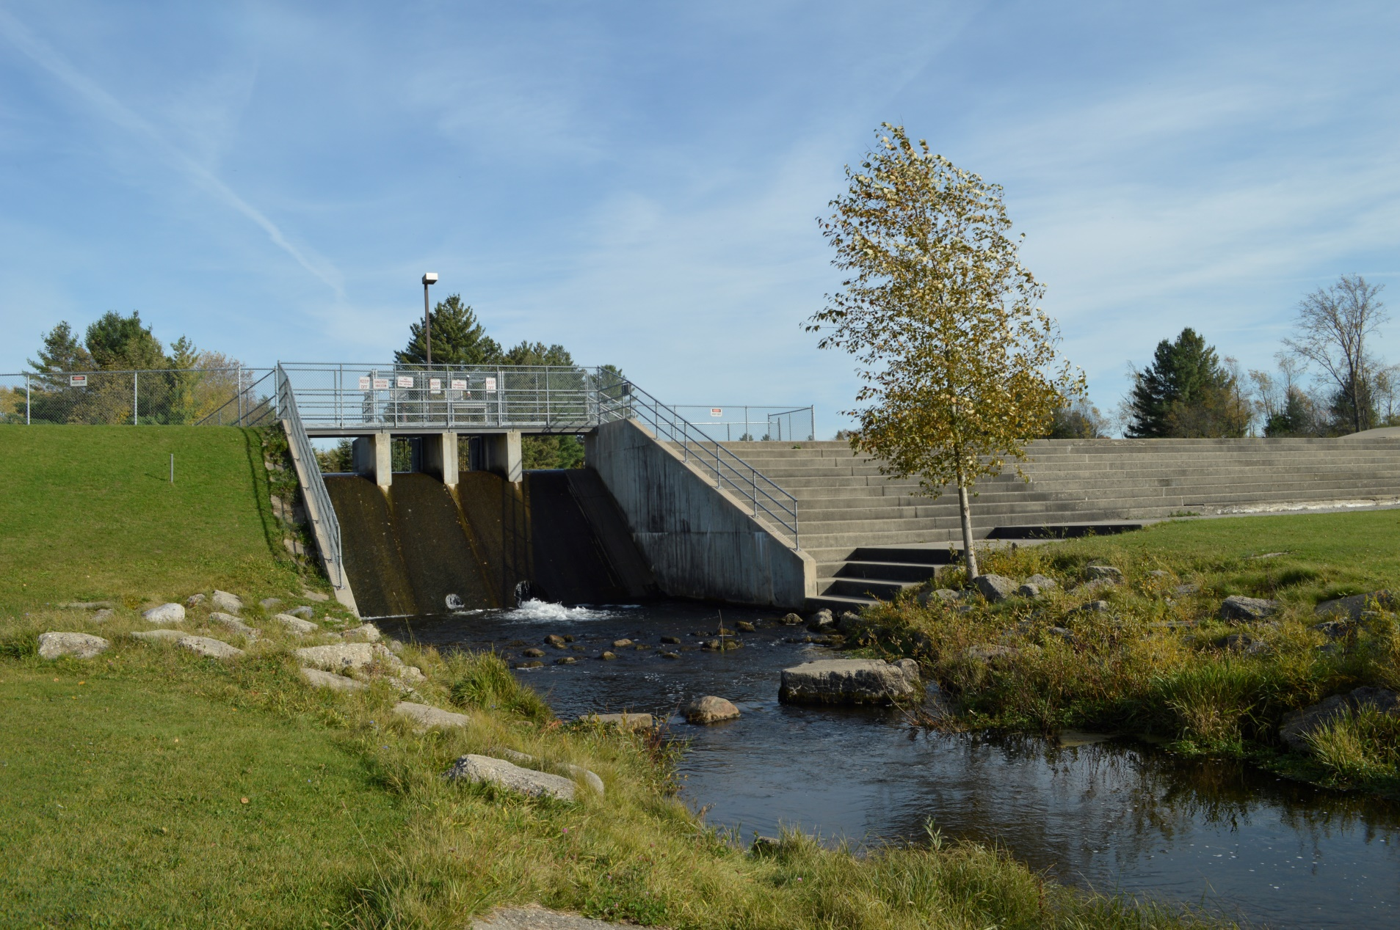
Luther Millpond Dam
Options: Maintain or Remove?

Slide 26

Questions?

