Slide 1
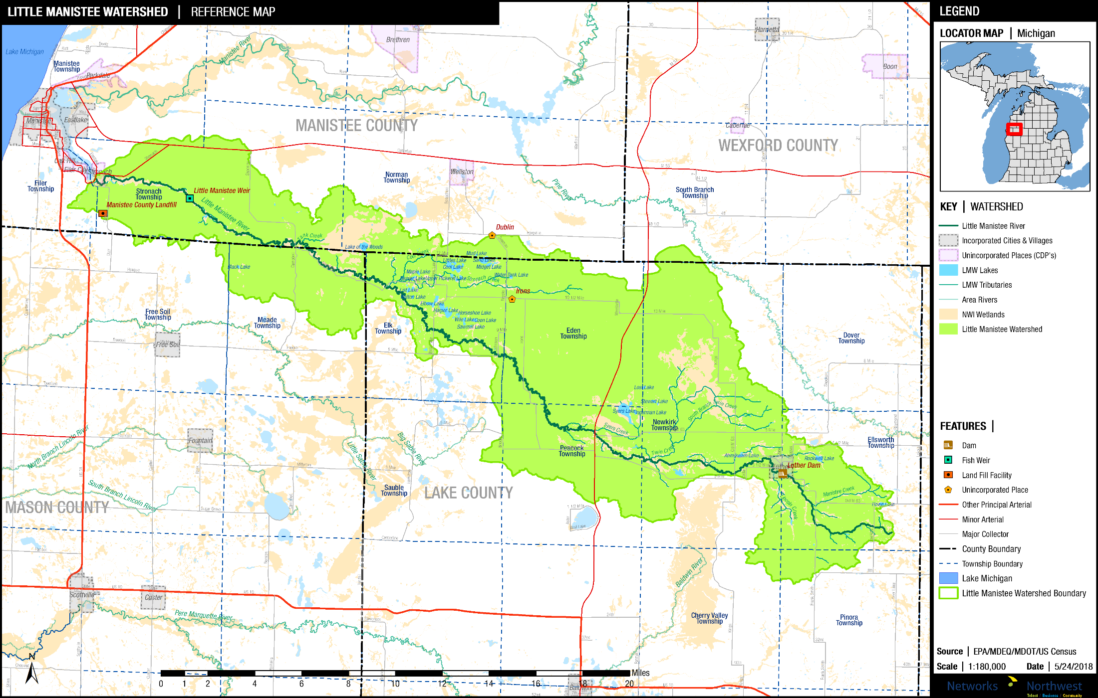
The Little Manistee River Watershed
Lake, Manistee, Mason and Wexford Counties

Slide 2
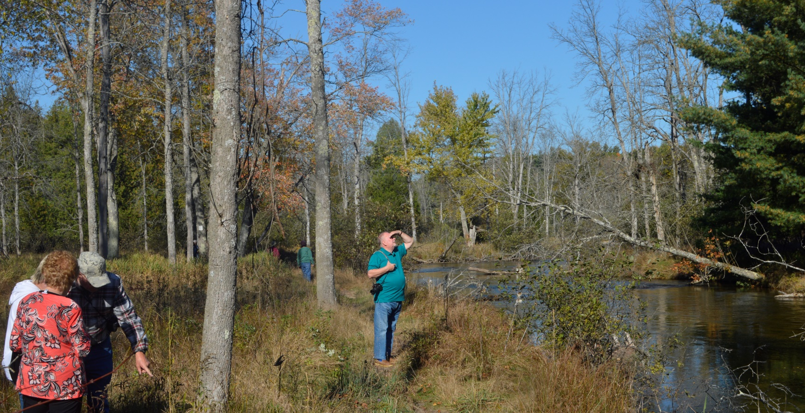
Why Watershed Planning?
Determine present conditions
Consider clean-water standards
Generate Stakeholder input
Begin Public Education
Identify problem areas
Develop solutions
Apply for funding
Monitor progress

Slide 3
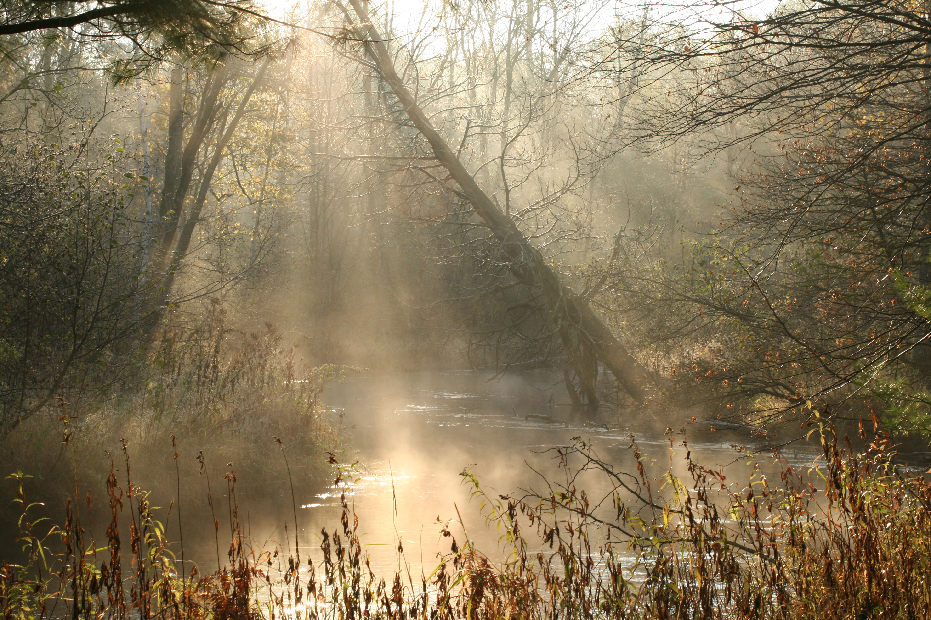
Plan Status
Partnered with Networks Northwest
Initial Draft Plan (LMWCC.org)
Public Reviews
Survey (LMWCC.org)
Now Updating Based on Input

Slide 4
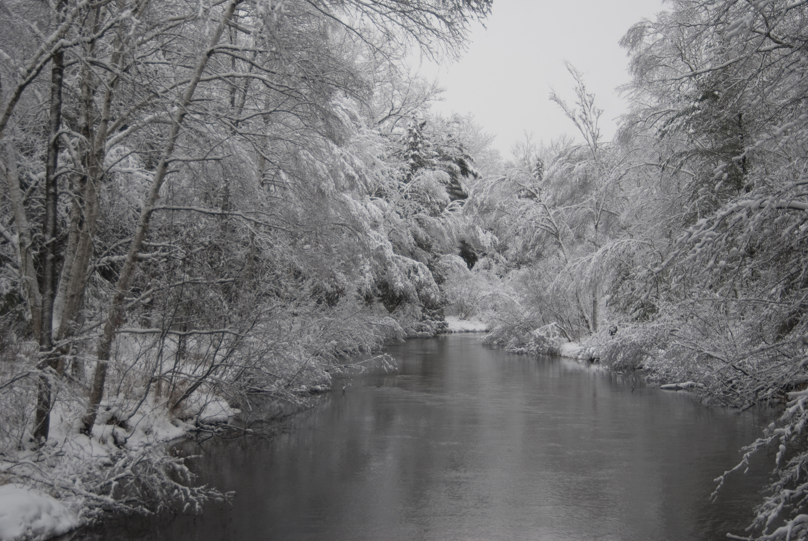
Next Steps
Review Final Draft
Submit for Approval
Implementation

Slide 5
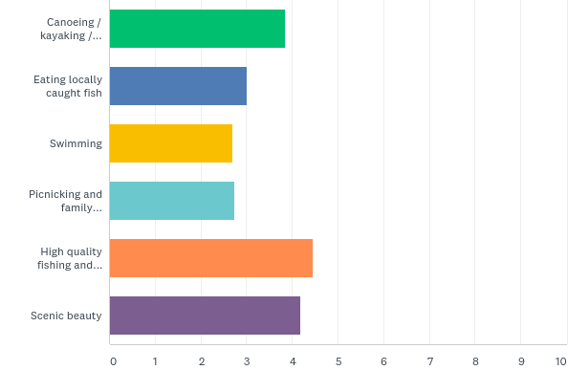
Q7: Please rank these activities (1st thru 6th) in order of their importance to you
Answered: 188 Skipped: 6

Slide 6
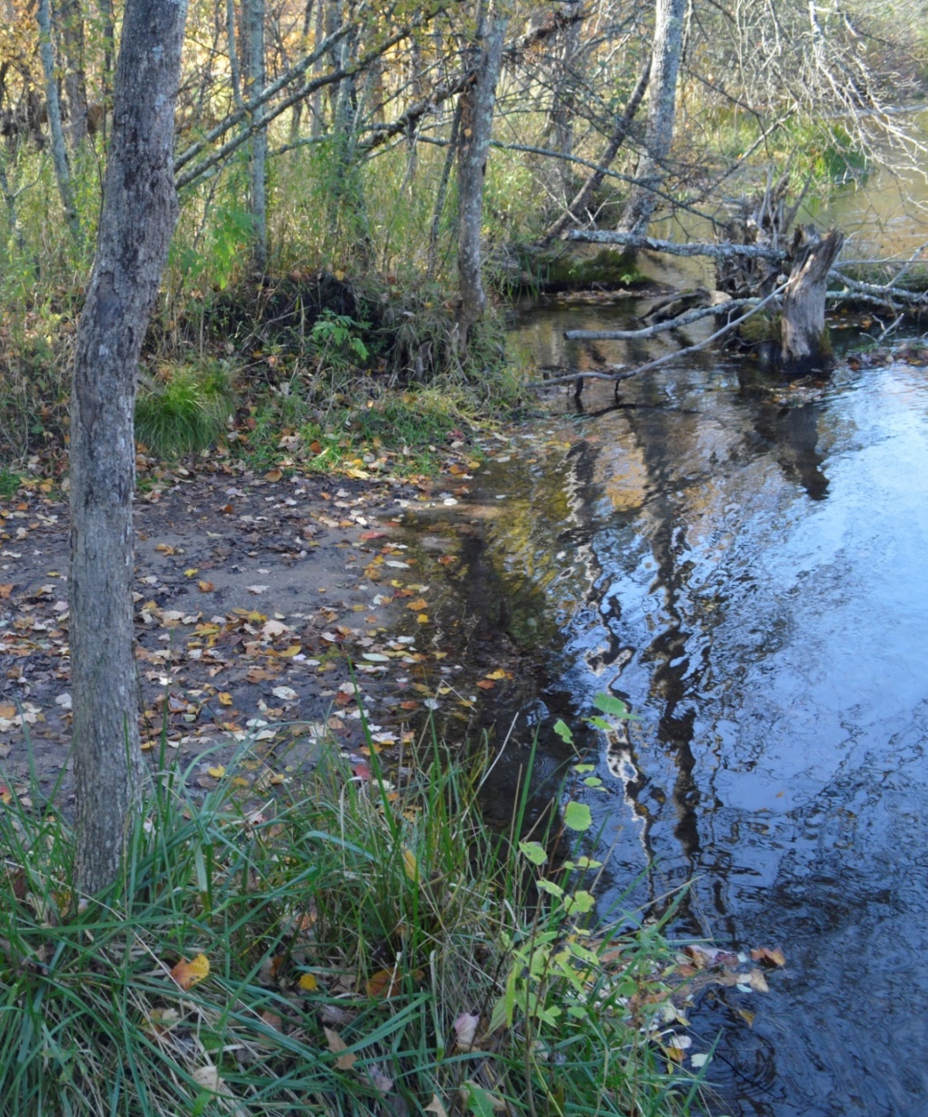
Non Point Source (“NPS”) Stressors
Little Manistee Watershed Priority Levels
Level 1
Thermal Issues
Sediments
Level 2
Excessive nutrients
Invasive Species
Biological pathogens
Level 3
Other unspecified
pollutants

Slide 7
Potential Sources of NPS Pollution
Land Use and Development
Transportation (Erosion at road-stream crossings)
Septic Systems (Nutrients and E. coli from failing systems)
Recreation (Erosion, spread of invasive species)
Agriculture (Fertilizer, pesticides, erosion)
Dams/Impoundments (Sedimentation, thermal issues)

Slide 8
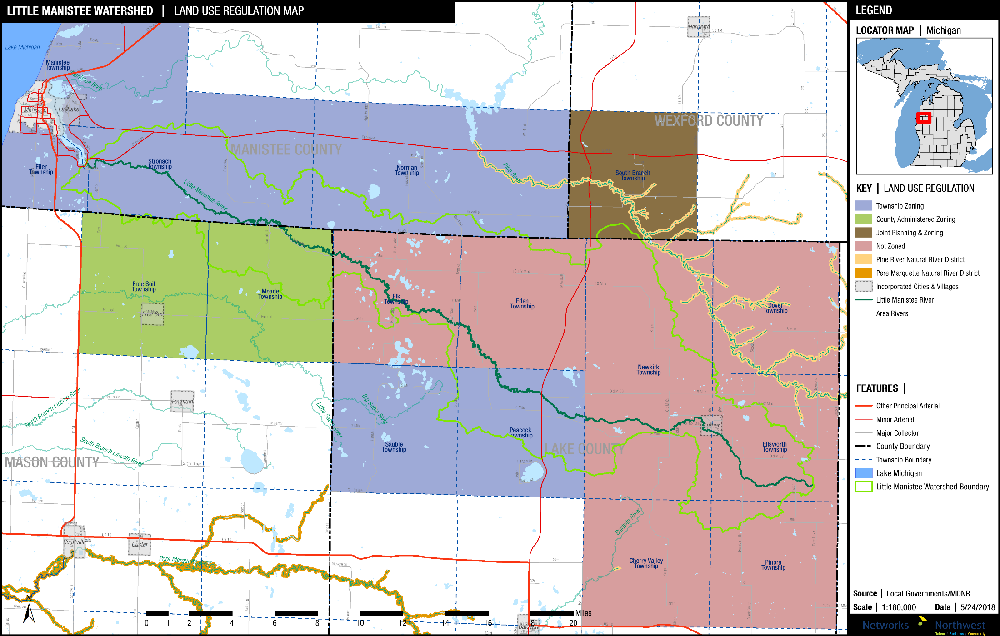
Existing Land Use Regulation

Slide 9
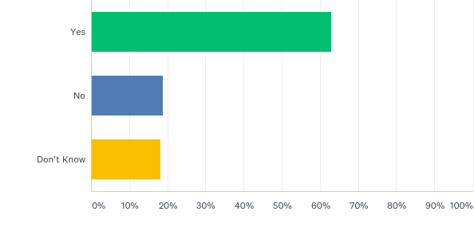
Q20: Strong local zoning, with requirements that buildings be set back from the river
Answered: 181 Skipped: 13

Slide 10
Planning & Zoning Best Practices
Environmental Protection Priorities
Economics of Environmental Stewardship
Wetland & Shoreline Protections
Buffers & Setbacks
Steep Slope Protections
Minimize Impervious Surfaces
Low Impact Develop (“LIDs”) Incentives

Slide 11
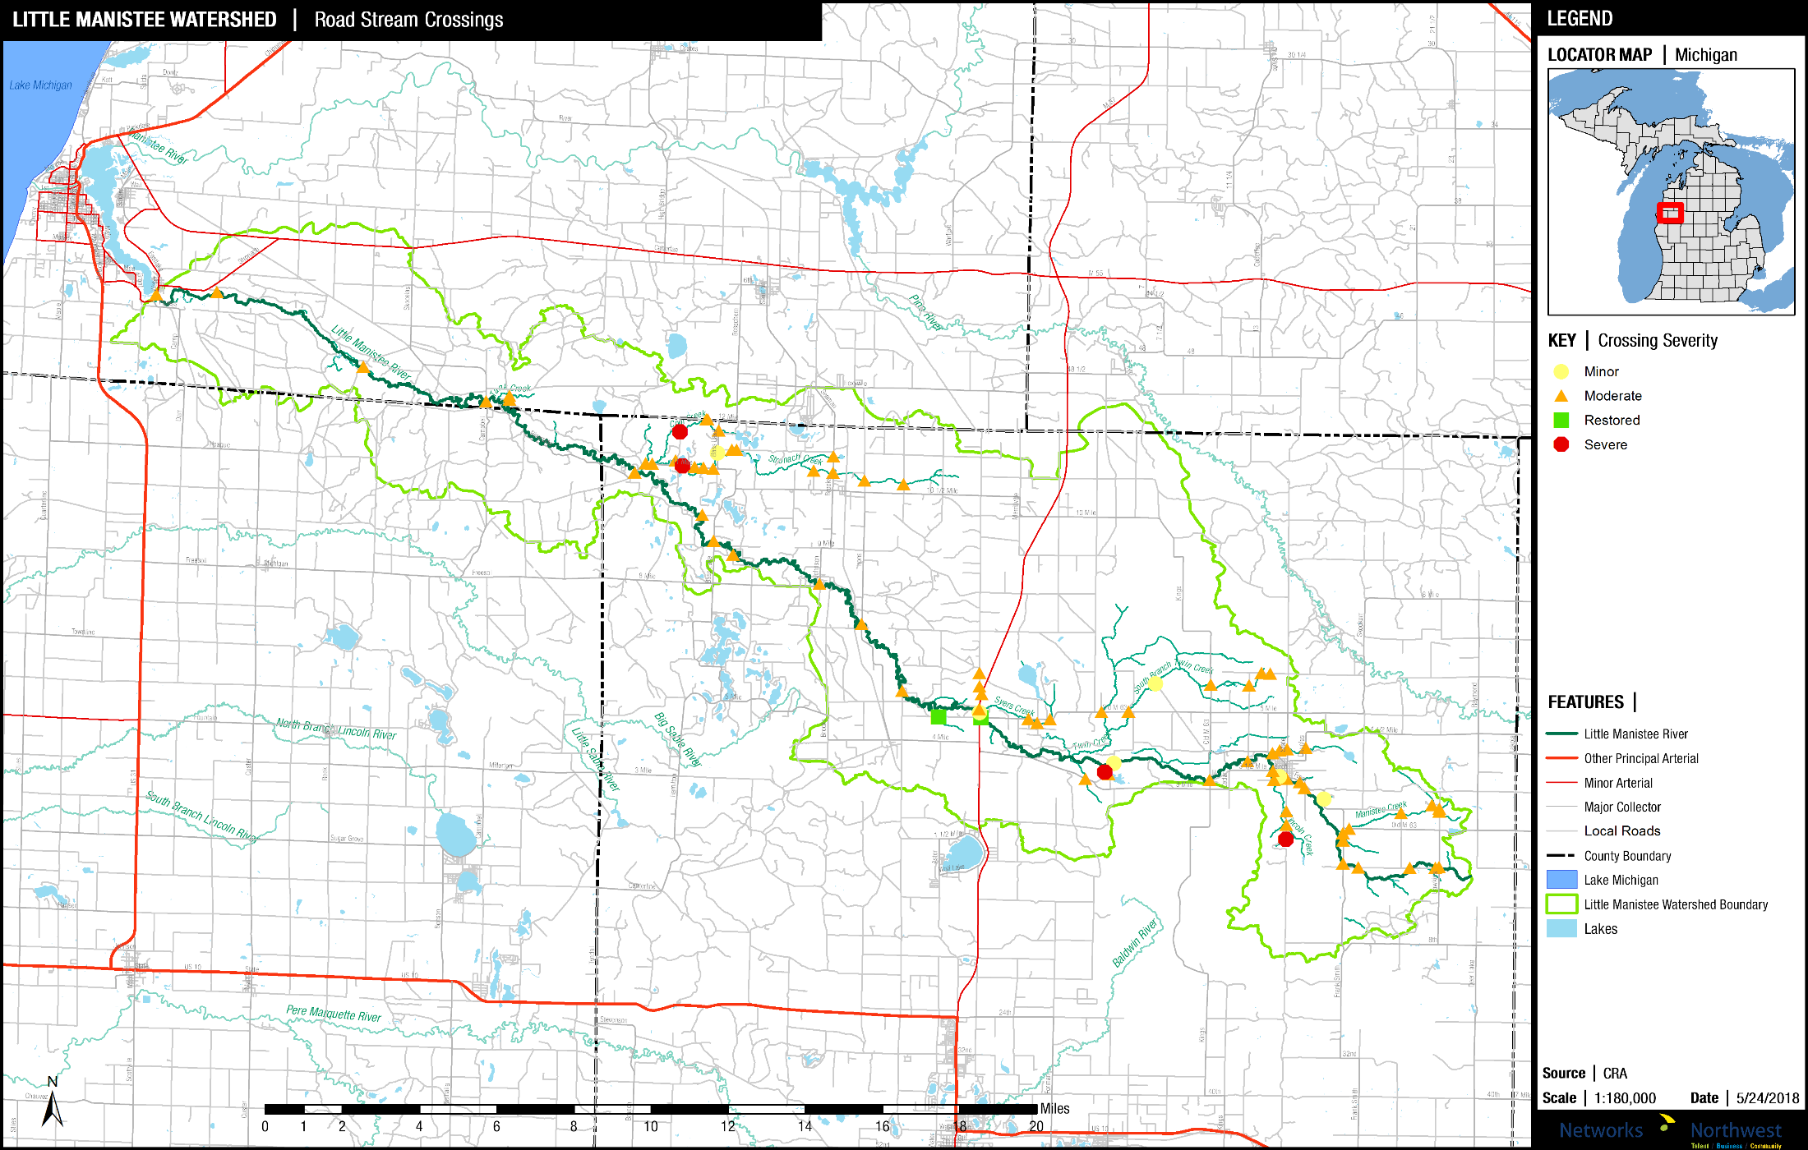
The Little Manistee Watershed has more than 80 road-stream crossings

Slide 12
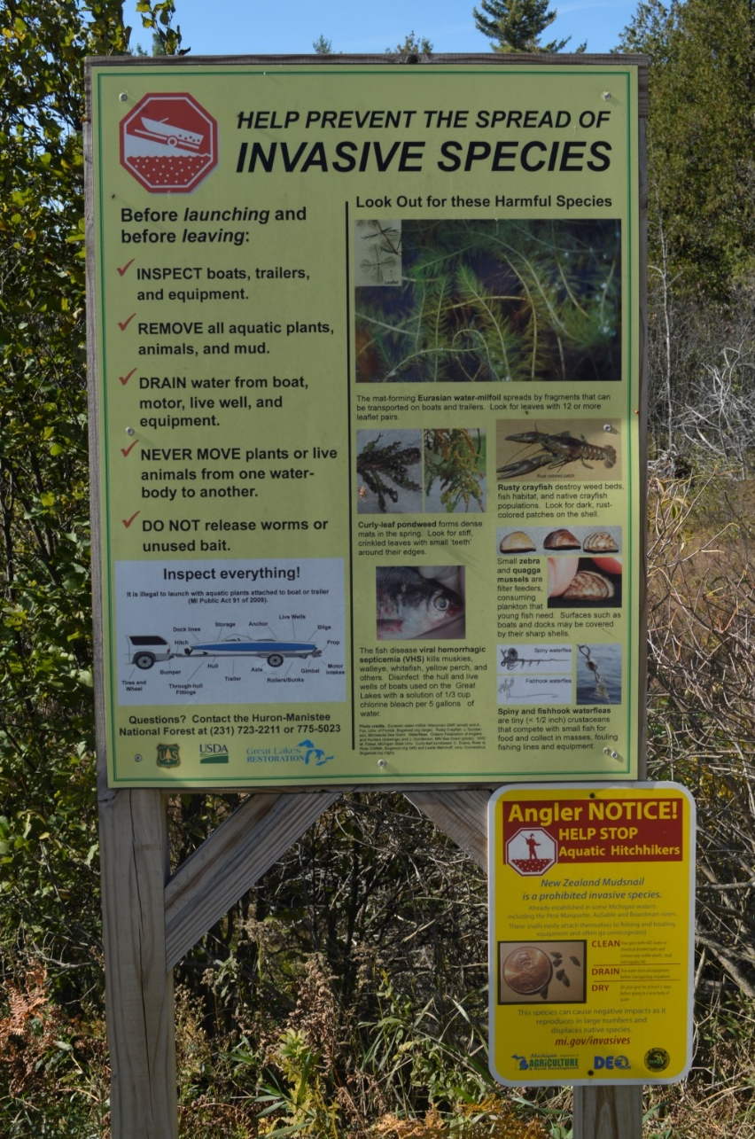
The Draft WMP Calls For:
Land Use Education
Water Quality Monitoring
Habitat Improvement
Streambank Stabilization
Road-Stream Repairs
Groundwater Protection
Optional Actions to Guide Future Land-Uses

Slide 13
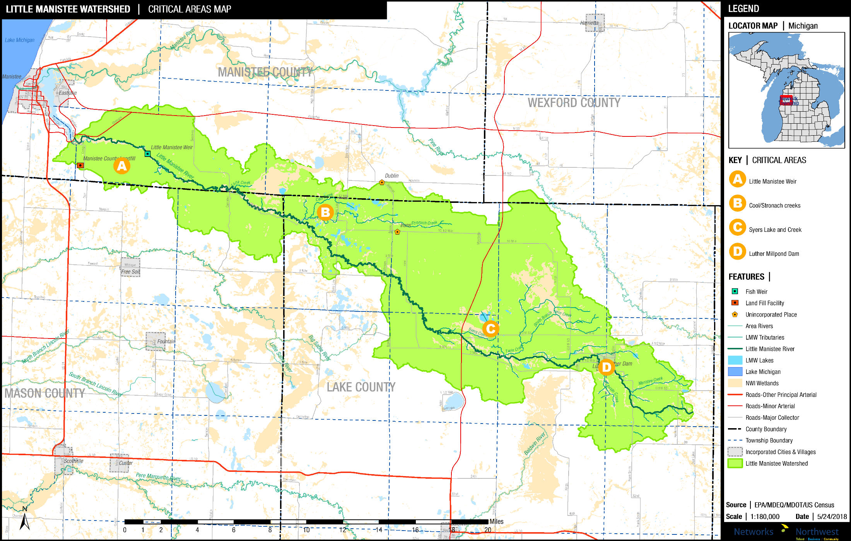
Critical Areas for Remediation and/or Protection

Slide 14
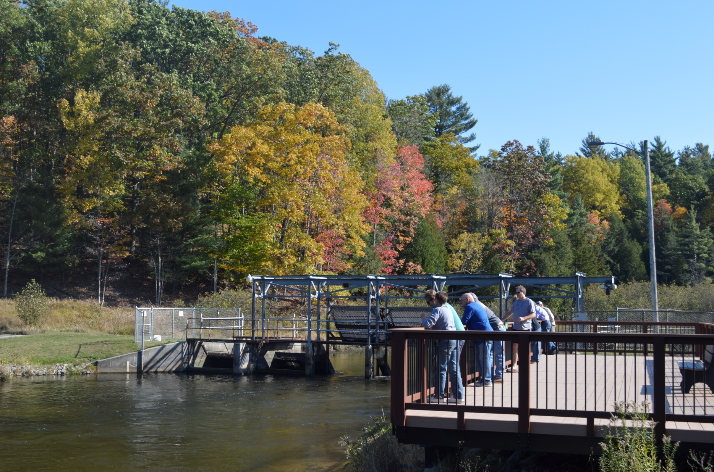
Little Manistee Weir and Egg-Taking Station

Slide 15
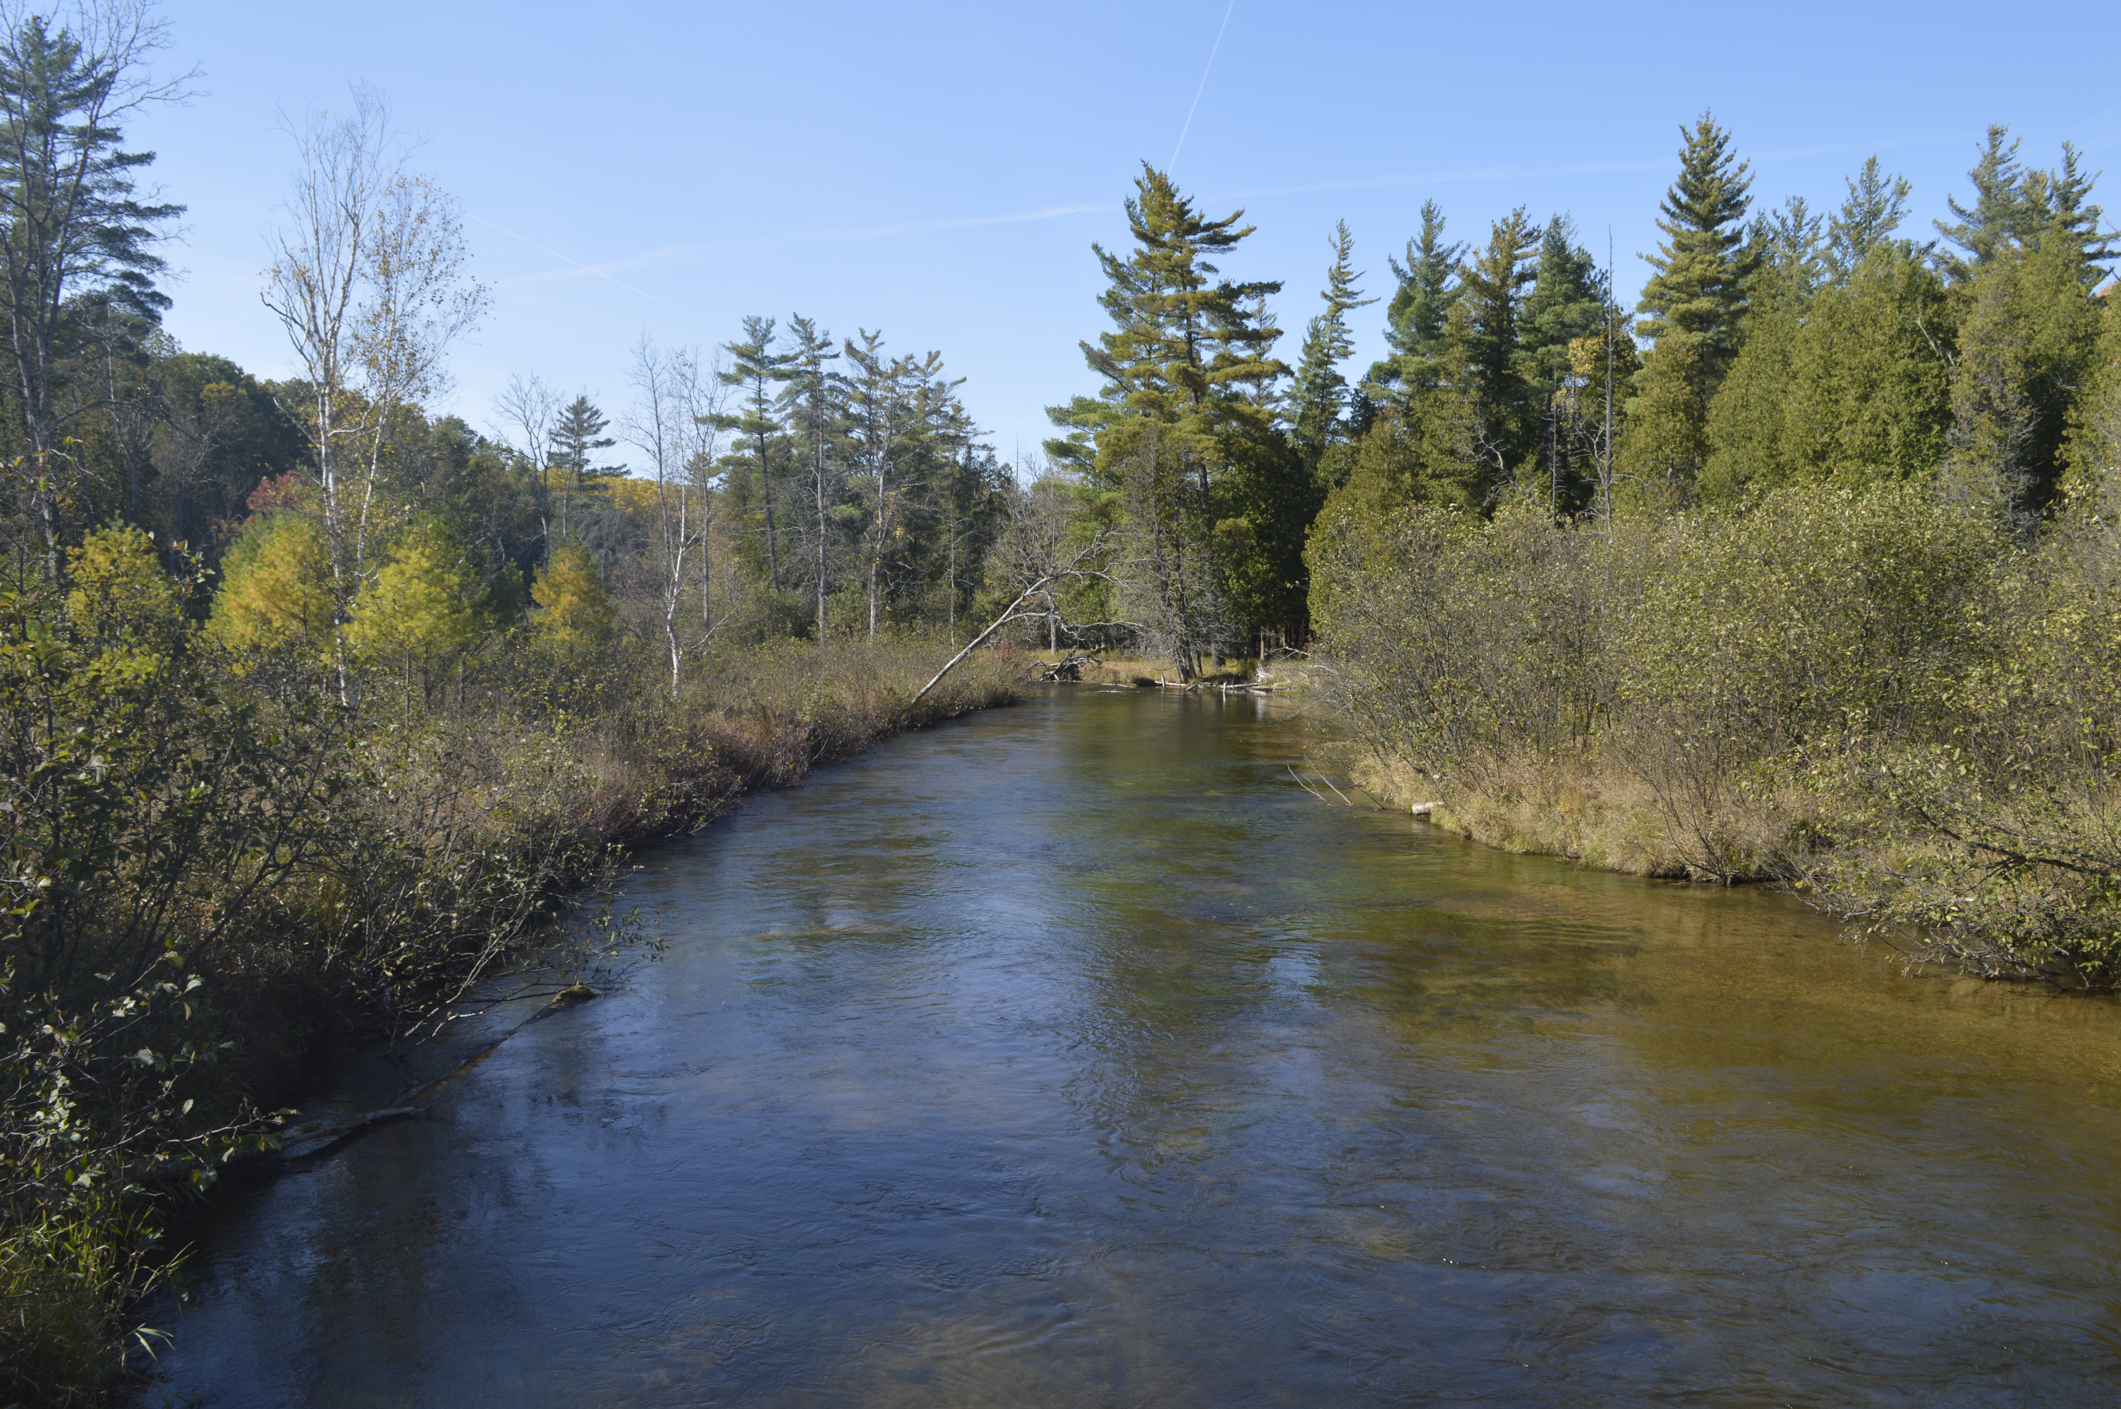
Cool Creek / Stronach Creek Critical Area
Syers Lake / Syers Creek Critical Area

Slide 16
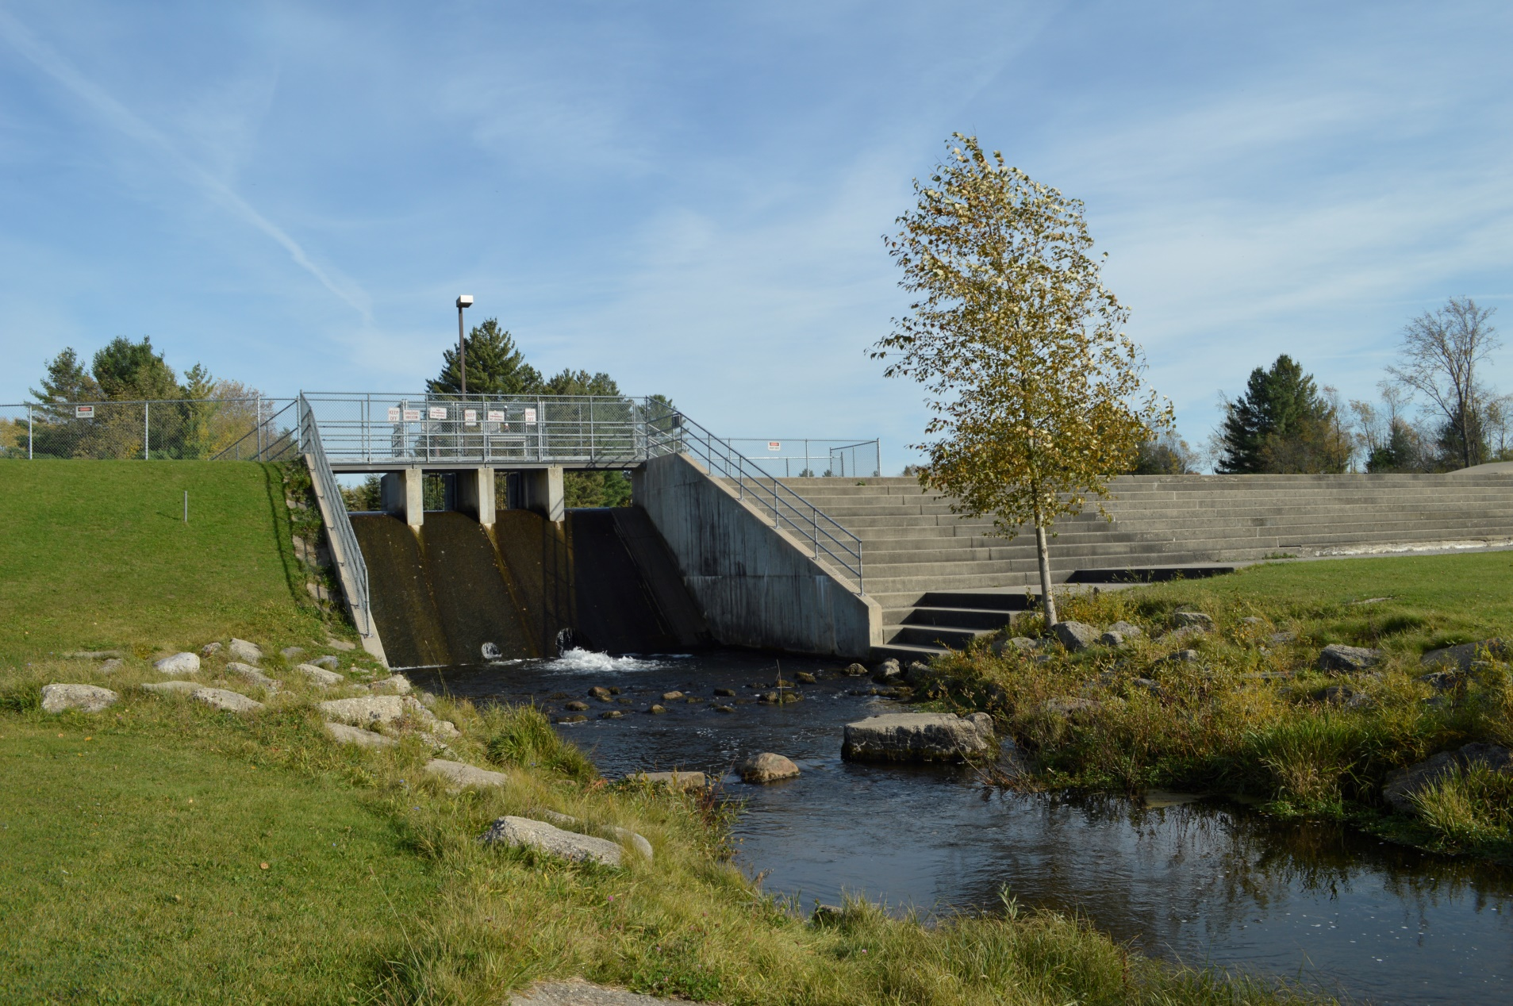
Luther Millpond Dam
Options: Maintain or Remove?

Slide 17

Questions?

Slide 18
Implementing the Little Manistee Plan
12 categories, 63 specific tasks

Slide 19
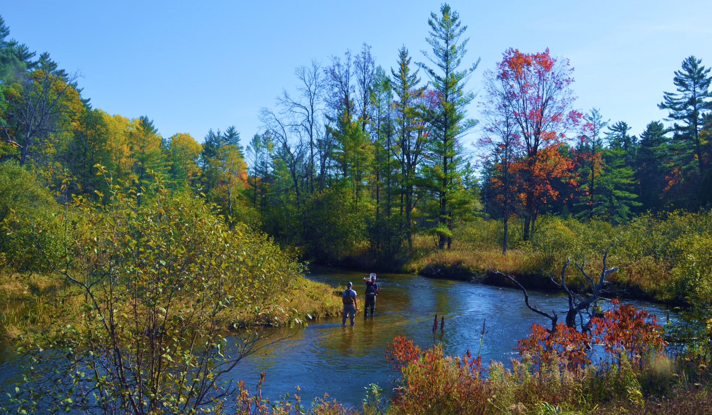
The Little Manistee Watershed
Planning for high-quality water

Slide 20
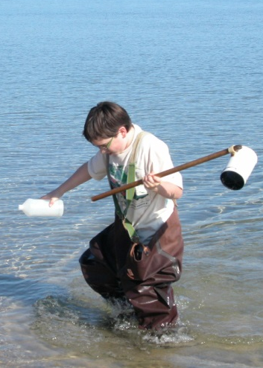
Watershed Questions:
What do we have?
What do we want?
How do we get from A to B?

Slide 21

Little Manistee WMP Partners
Little Manistee Watershed Conservation Council
Conservation Resource Alliance
Manistee Conservation District
Lake County Community Foundation
Manistee County Community Foundation
U.S. Forest Service
Michigan DNR and DEQ
Little River Band of Ottawa Indians
Trout Unlimited
Local government agencies
Alliance for Economic Success

Slide 22
The Plan MUST:
Maintain or improve water quality
Meet standards for full-body contact recreation
Protect or improve the fishery
Protect navigation
Include public education

Slide 23
The Plan MAY:
Consider scenic and recreational values
Address economic conditions
Include public access
Add locally important issues

Slide 24
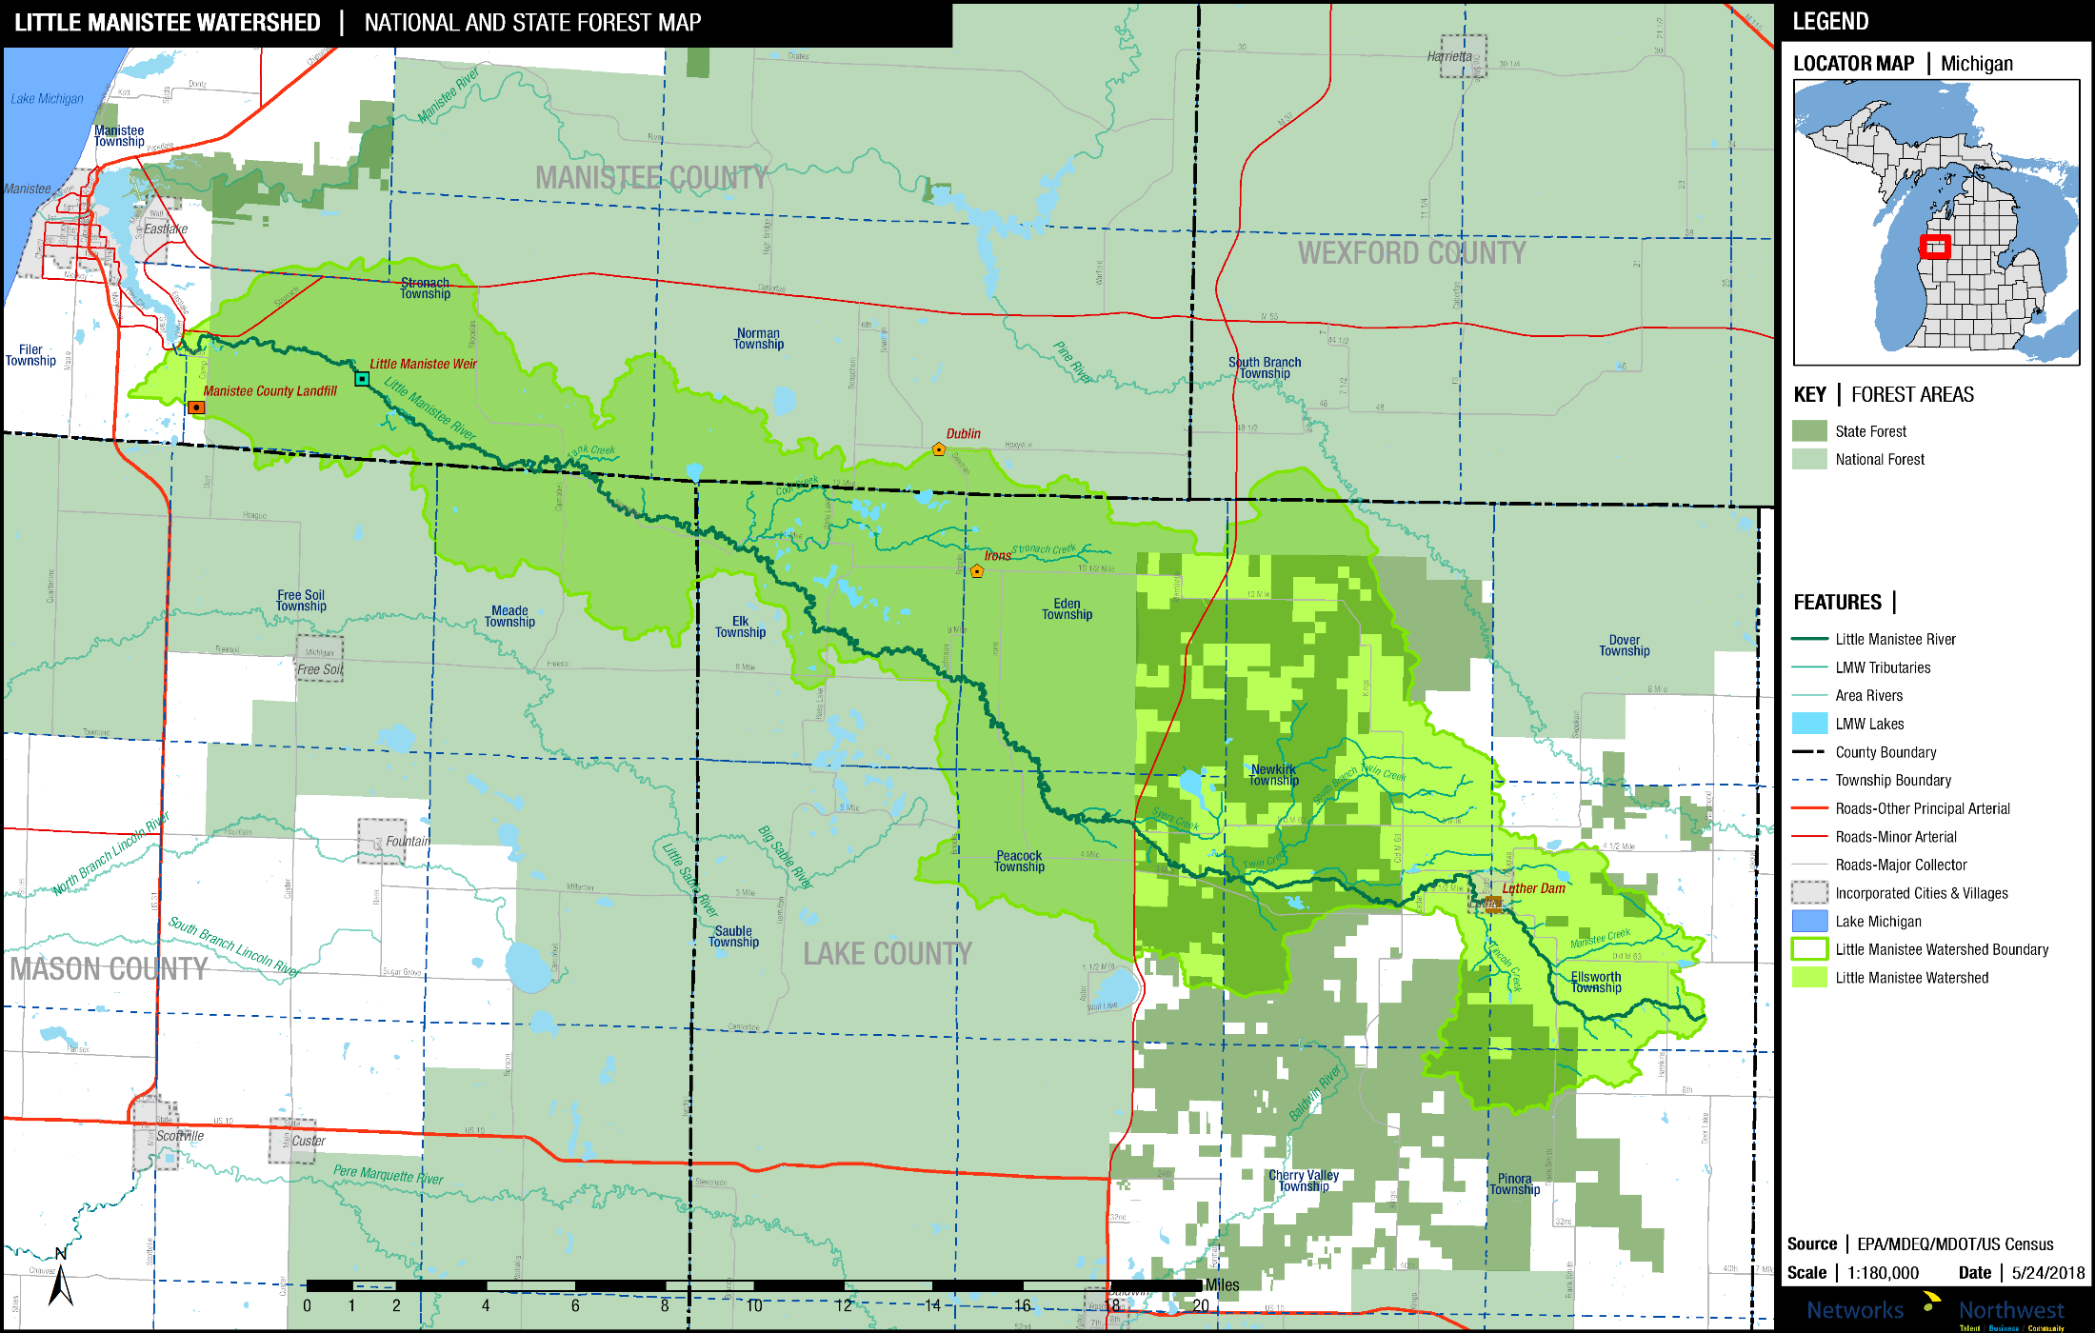
State and National Forest Lands

Slide 25
Zoned Area of Watershed (Acres)
Zoned Township Administered 42,854
Zoned County Administered 10,929
Joint Planning & Zoning 626
Total Zoned in Watershed 54,410
Total Watershed Area (Acres) 134,995
% of Watershed Zoned 40.3%

Slide 26
Land Cover in Little Manistee Watershed
Vegetation Type
Deciduous Forest 39.1%
Mixed & Evergreen Forest 28.3%
Scrub & Grassland 14.2%
Land Use
Developed 5.0%
Agriculture 3.5%
Water & Wetlands 9.7%

Slide 27
Implementation Categories A-B-C-D
Shoreline/Streambank Issues $449,000
Stormwater and Runoff $74,000
Planning, Zoning and Land Use $25,000
Road-Stream Issues $4,292,000

Slide 28
Implementation Categories E-F-G-H
Cat. E. Land Protection and Management $1,010,000
Cat. F. Habitat for Fish and Wildlife $280,000
Cat. G. Recreation, Safety, Navigation, Health* N/A
Cat. H Groundwater and Wetlands $40,000
(Cat. F estimate does not include option for dam removal)
(Cat. G costs are included in other line items)

Slide 29
Implementation Categories I-J-K-L
Water Quality Monitoring $70,000
Invasive Species $18,000
Wastewater and Septic Systems $335,000
Information and Education $81,000

Slide 30
Total Implementation Costs Estimate
TOTAL 10-year Cost: $6,686,000

